Slide 1
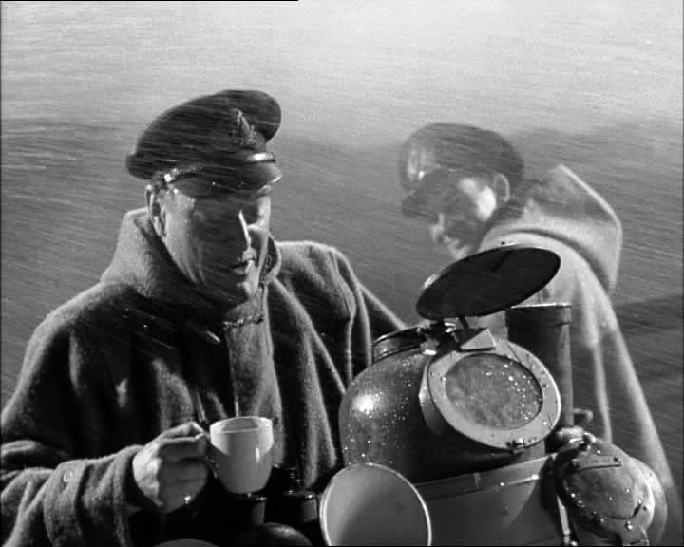
Imagine you are England. Everyone is paying to see American films. What do you do?

Slide 2
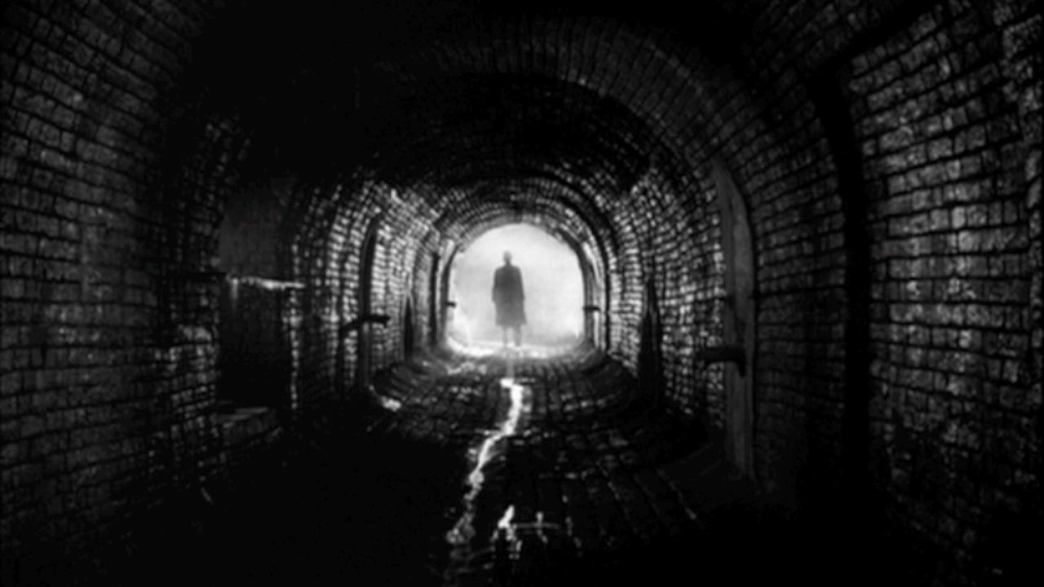
Subject Matters in British Film –The “Academic Tradition”
British Wartime experiences (The Cruel Sea, The Dam Busters)
Literary, dramatic, or historical heritage (Brief Encounter, Great Expectations, Shakespeare)
Sophisticated crime or espionage thrillers (The 39 Steps, Peeping Tom, James Bond)

Slide 3
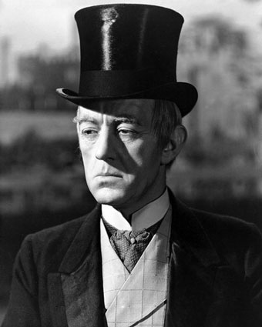
The goal of British film is not of artistic quality, but one of national identity
Self-effacing (Being British is always present, but usually stuck in the background)
British humor and progressive politics
Gothic fantasy and horror
Much of the British persona that we know of today in film comes from JOHN GRIERSON
Prewar documentarian
300 documentaries came out of the 1930s from England, New Zealand, Australia, South Africa, and Canada
This became for model for documentaries in English speaking countries

Slide 4
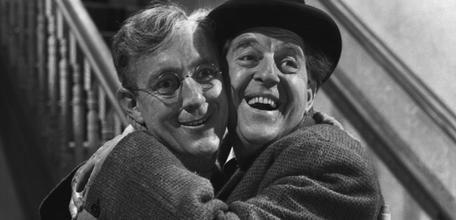
Ealing comedies –mimics the format of the prewar documentary after it had disappeared
Michael Balcon, head of Ealing Studios, was a fan of the prewar documentary
Hires three major directors all from pre-war documentary era: Charles Crichton, Charles Frend, and Alexander Mackendrick
Major films from Ealing: A Run for Your Money (1949), Kind Hearts and Coronets (1949), The Lavender Hill Mob (1951), The Man in the White Suit (1951), and The Ladykillers (1955)
Filmed seriously with cartoonish characters

Slide 5
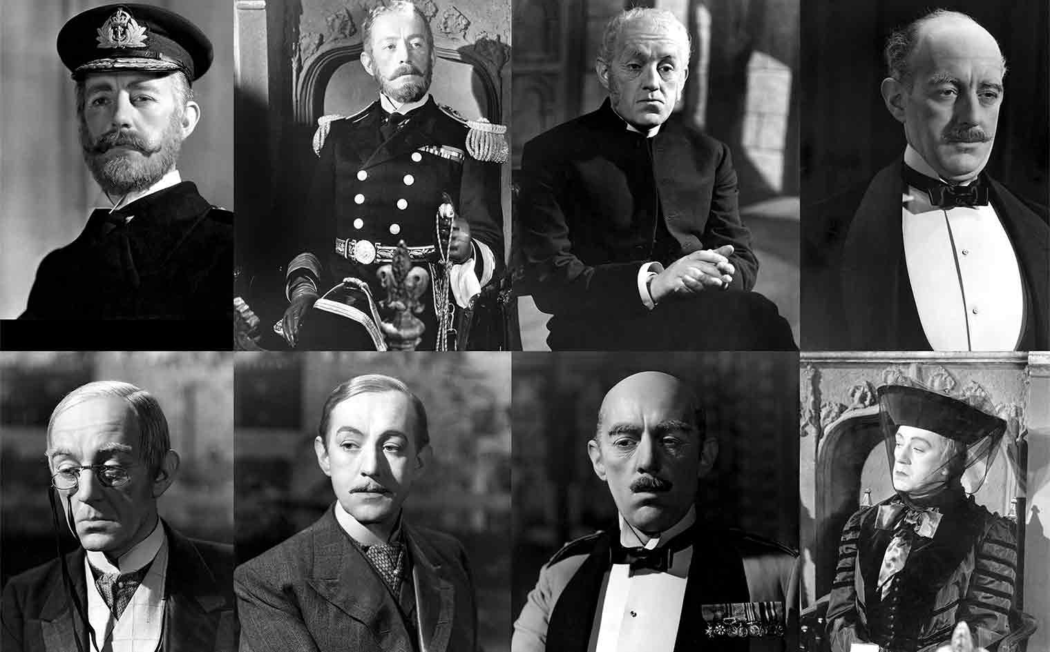
https://www.youtube.com/watch?v=PeZQkHimHjo

Slide 6
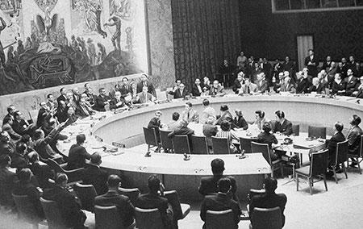
Free Cinema and Social Realist features (or why 1956 changed everything)
British failure to invade Suez
Last year of “Imperial arrogance”
People stop trusting the government
Stalin invades Hungary; Marxist left abandons communism
“New Left” forms (similar to American left) –abandons socialism
Working class –dubbed “Angry Young Men” due to the protests against the government
Documentary returns under banner “Free Cinema” (free from sponsors and free from box office demands)
“Implicit in our attitude is a belief in freedom, in the importance of people and in the significance of the everyday.”

Slide 7
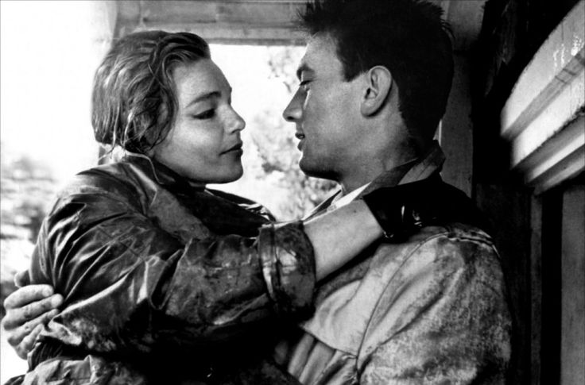
SOCIAL REALISM: Focus on the working class character and his or her problems
Starts with Room at the Top (1959 –Jack Clayton) and Look Back in Anger (1959 –Tony Richardson)
Both director part of Free Cinema movement
Lindsay Anderson –directed This Sporting Life, possibly the most well known of the social realist movies, somewhat ends the movement by including surreal aspects to the film

Slide 8
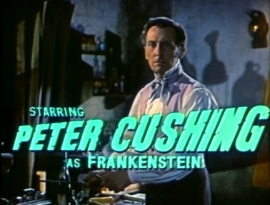
The Gothic Strain
Britain makes post WWII horror movies
Adds sexuality
Hammer Studios remakes classic monster movies with a more grotesque element than Universal
Famous actors: Peter Cushing; Christopher Lee

Slide 9
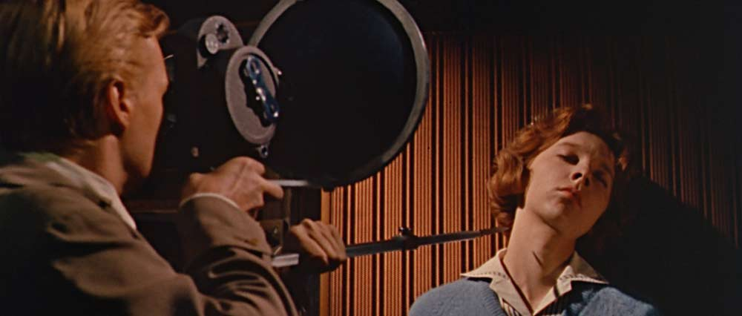
Michael Powell and Emeric Pressburger (The Archers)
Known for producing beautiful images
The Red Shoes (1948) –realistic look into the world of ballet; a “meditation on the meaning of art”
Black Narcissus (1947) –a study in repressed sexuality
Two ideas come together for Peeping Tom

