Slide 1
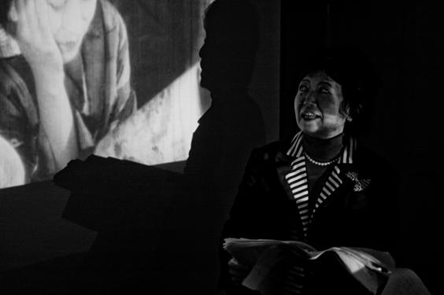
Why did it take a long time for Japan to adapt to sound films?

Slide 2
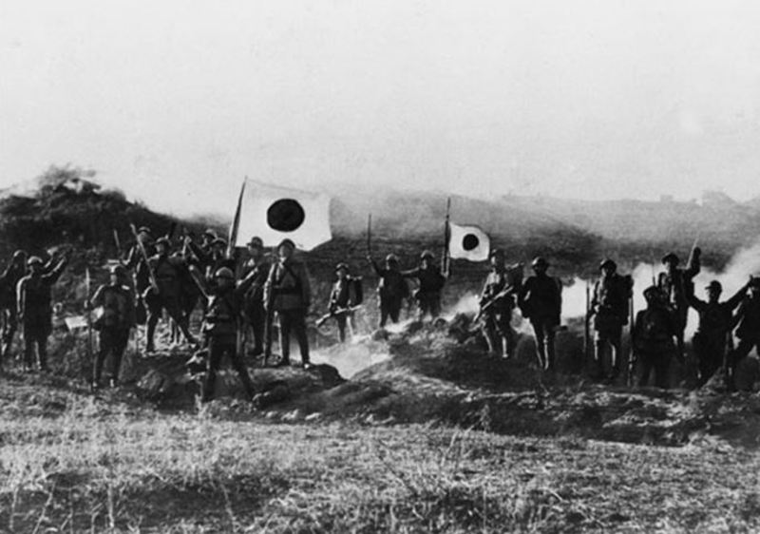
Early Days of Japanese Film
Strong start (1904-1905)
Tokyo earthquake in 1923 causes regrouping
Mid-1930s: adaptation to sound
Post WWII: Censorship limited film tradition (American occupation)
Over 95% of pre-1940s films lost or destroyed
Six classic studios

Slide 3
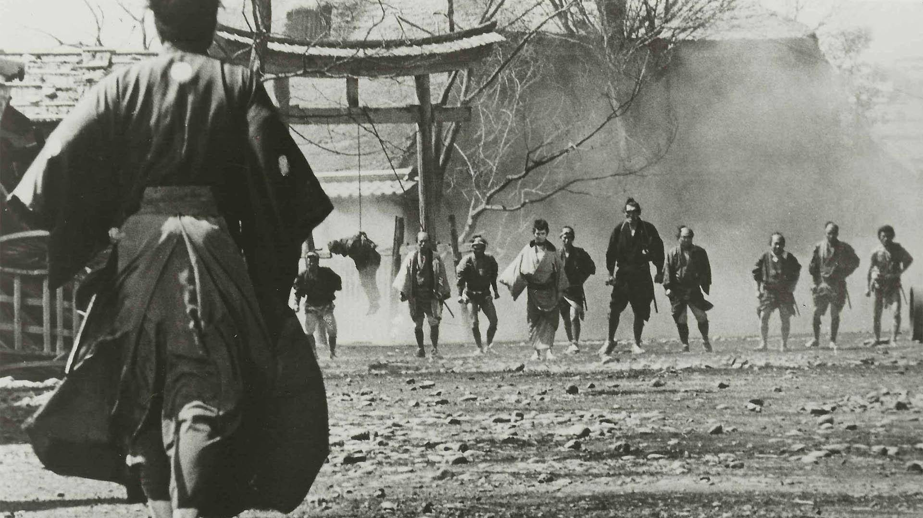
Jidai-geki (or jidaigeki) –historical film: any film set before 1868
Emperor Meiji acceded to the throne
Japan first opened up to commercial and cultural exchange with the West
End of feudalism
Accounts for 40% of films made

Slide 4
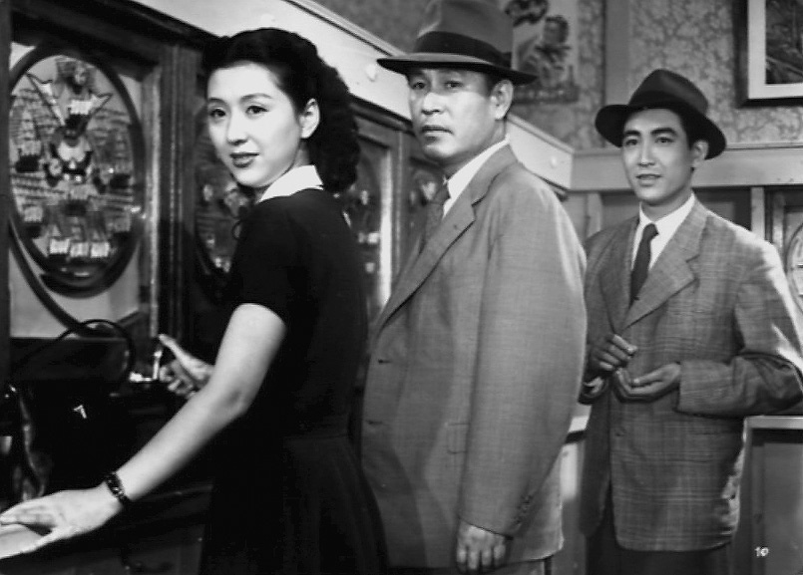
Gendai-geki- contemporary films
Traditionally appeals to Japanese audiences
Jendaigeki –appeal to both domestic and international audiences

Slide 5
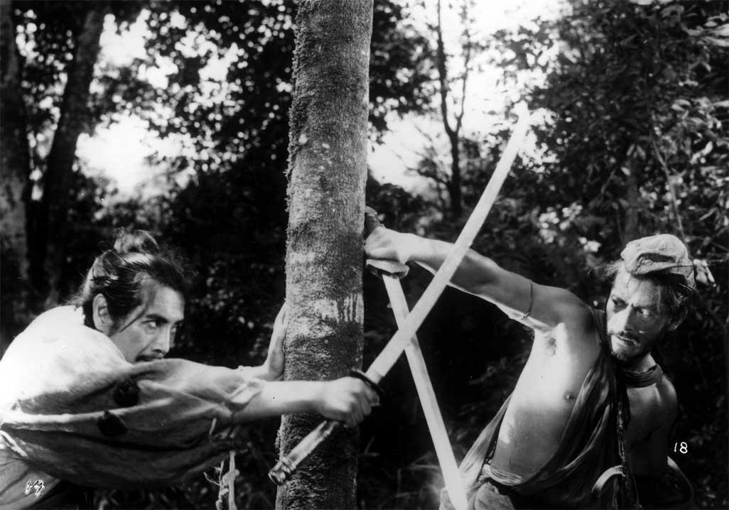
Rashomon
Directed by Akira Kurosawa
First international attention to Japan
1951 –Venice Film Festival
Daiei Motion Picture Company –Japan’s most prestigious studio
Released Ugetsu (Misoguchi), Gate of Hell (First Eastman color), Seven Samurai (Kurosawa, condensed version)
Toshiro Mifune becomes famous

Slide 6
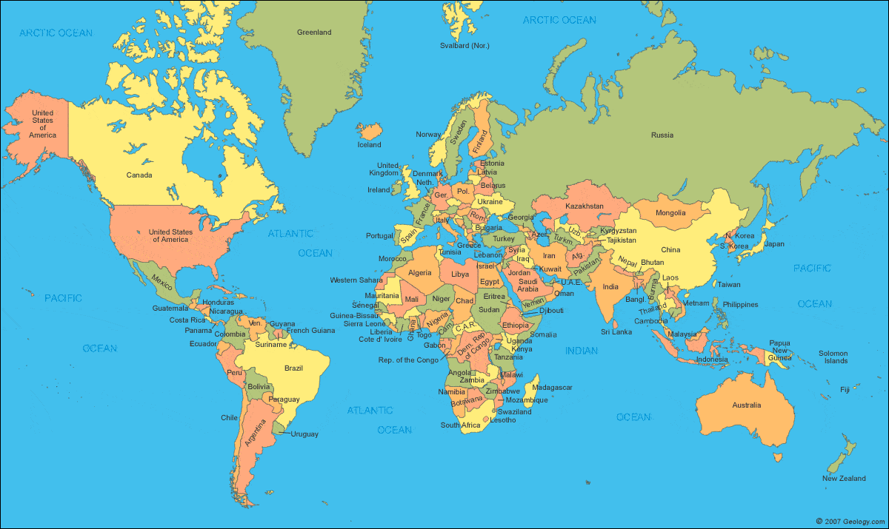
European films
-concerned with psychology of character
American films
-concerned with action and entertainment
Japanese Films
-concerned with mood and atmosphere
NOTE: Even though the world hadn’t been watching Japanese films, Japan had been watching the worlds’ films

Slide 7
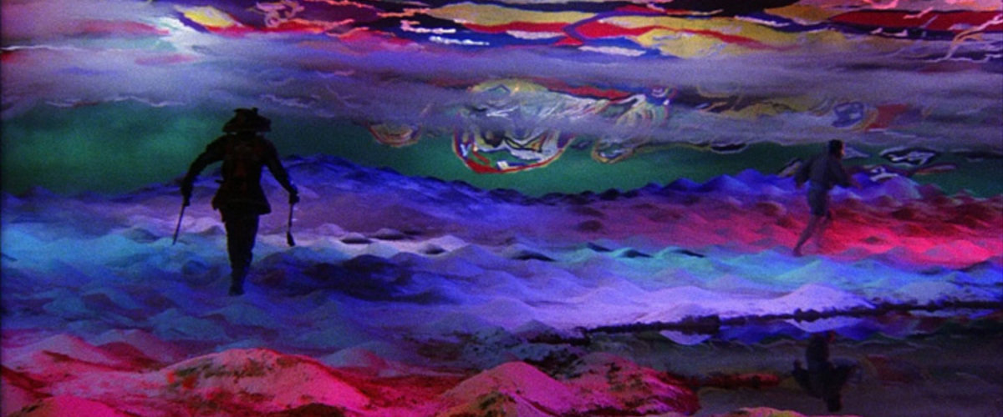
The Japanese Style
Americans would view it as “sentimental”
Somewhat didactic
Slower pacing
Shots and scenes extended beyond necessity to let audience emotionally process
Long passages without dialogue give emphasis to image
Importance on visual arts
Cinematographers thought as painters

Slide 8
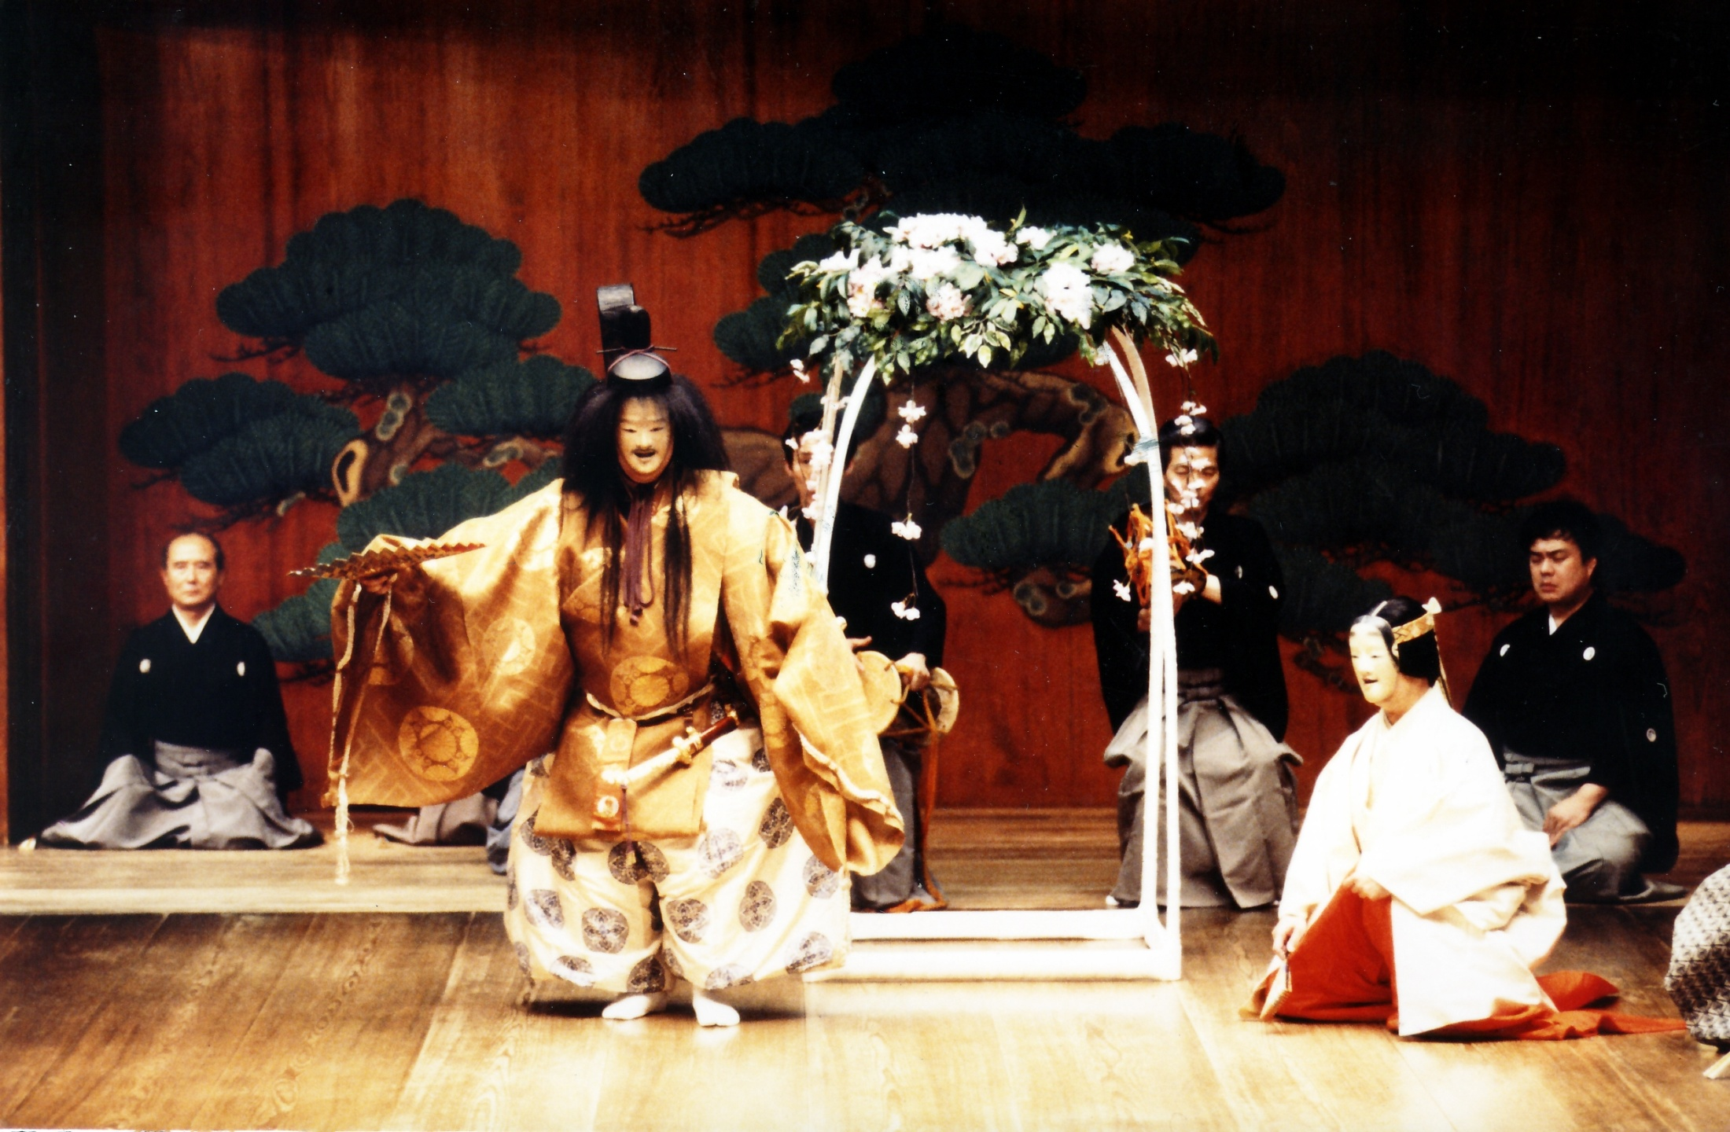
Performance style was based on traditional Noh (or No) theater or Kabuki style. It reflects that national sentiments and beliefs of older Japan

Slide 9
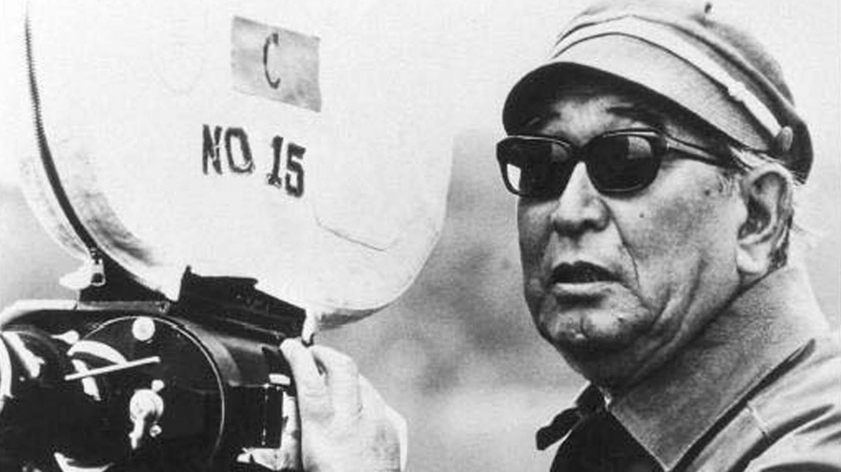
Watch the Akira Kurosawa movie assigned to you
Create a posterboard about Akira Kurosawa’s life, philosophy, and film history
In a section of the poster, give a brief background to your film and explain why the film either lives up to or contradicts your research.
Email me notes on Akira Kurosawa that I can include on the test / website

Slide 10
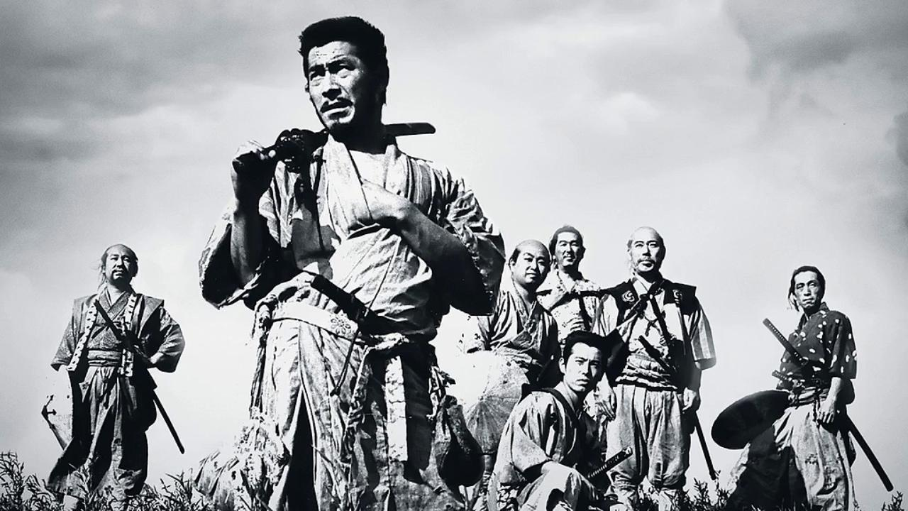
OPTIONAL PROJECT
Watch The Seven Samurai, The Magnificent Seven (1960), The Magnificent Seven (2016) and give a presentation along with a 2 page essay on the three movies.
This will replace your exam on Japan
You may use these films for your weekly independent viewings
You may substitute the 2016 version for the anime Samurai 7

Slide 11
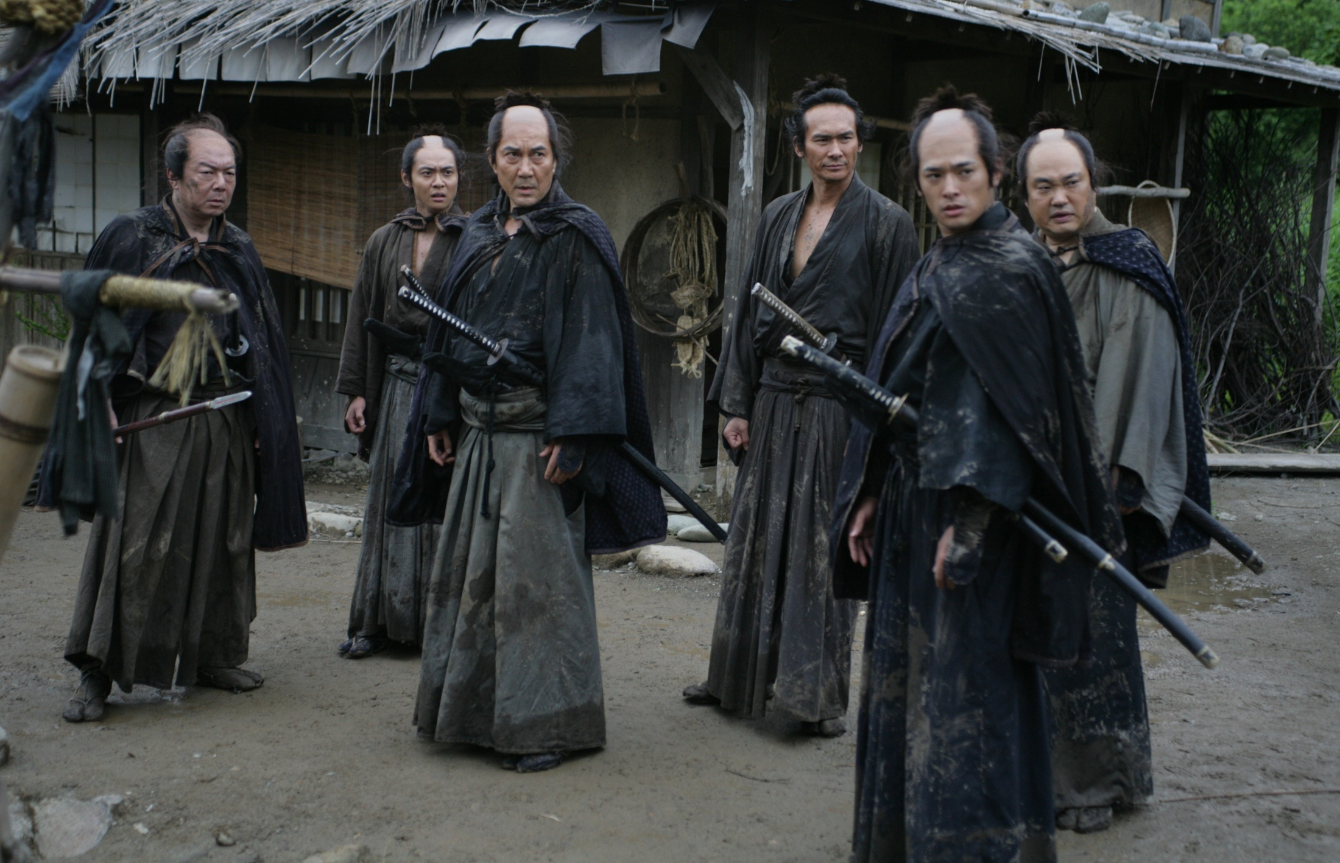
What makes jidaigeki so appealing to Western audiences?

Slide 12
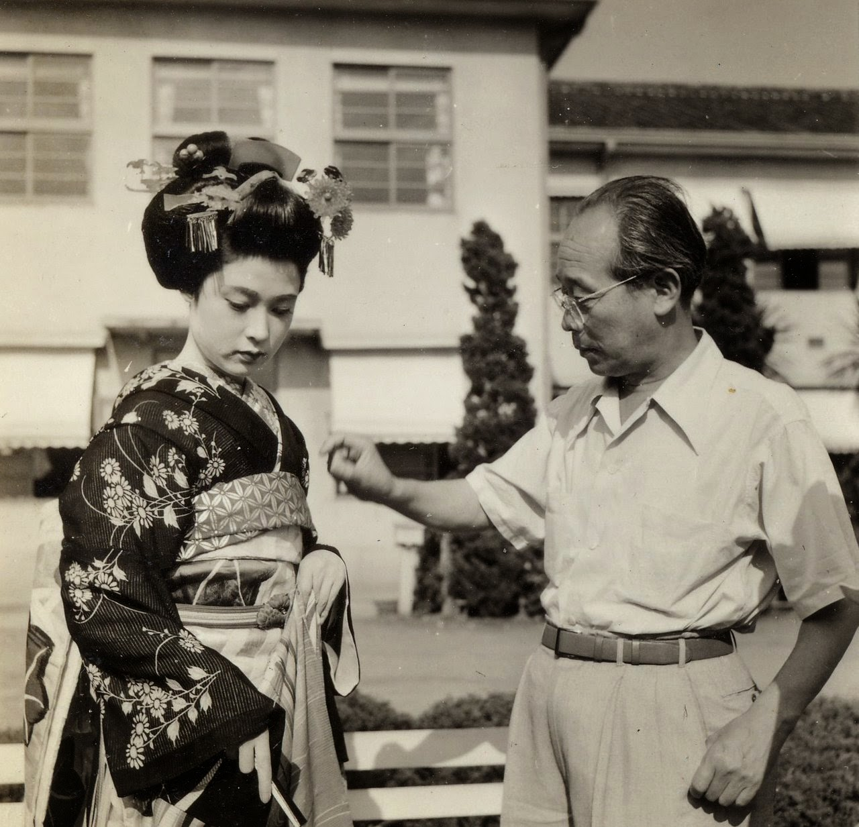
Kenji Mizoguchi
More traditional than Kurosawa
Limited appeal to Europe and U.S.
Favored jidaigeki
Focused on plight of women; worked for women’s rights
Common themes: prostitution; self-image; power within the family
Sequence shot –whole scene done in one take
Leisurely tracking shots
Most famous film: Ugetsu –deals with war and the human condition

Slide 13
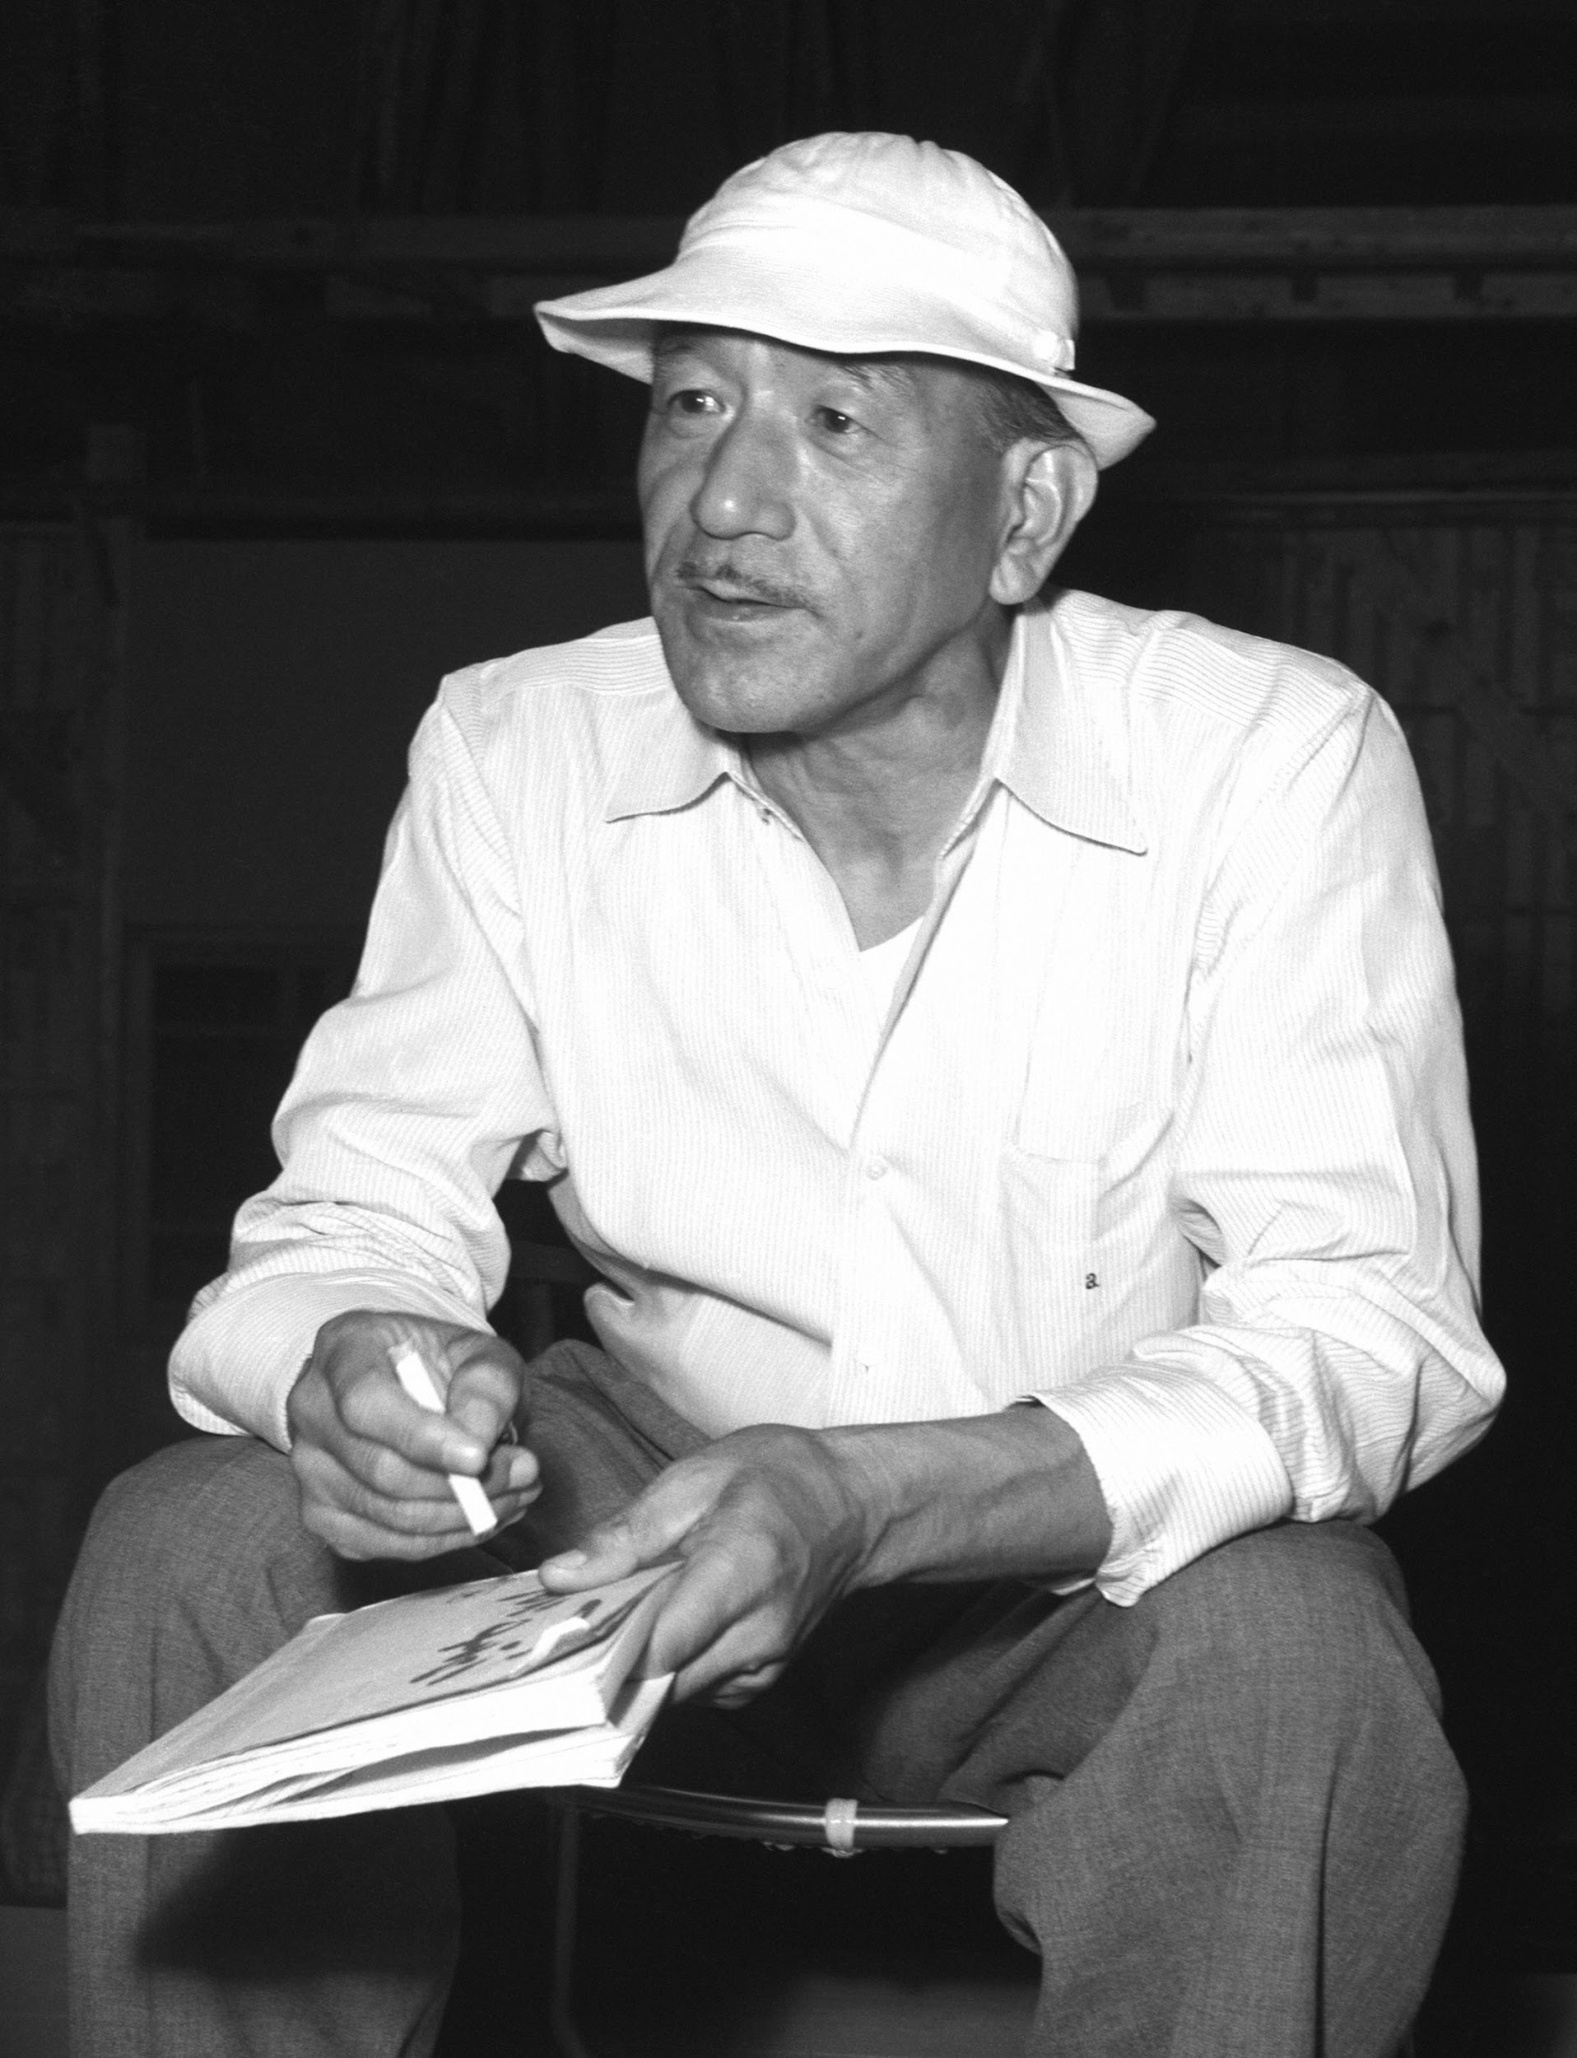
Yasujiro Ozu
Extreme traditionalist
Themes often focused on the battle between tradition and the new ways in Japan
Rarely moved camera in later films; only to accommodate action
Mostly shot interiors
Most action simply a conversation between two people; often an older and a younger person
Maintained old aspect ratio, but moved to color.
Even when moved to color, muted the palate.
Considered most “Japanese” in terms of tone out of Kurosawa or Mizoguchi
Sad to see the old go, but admits without complain
Camera often at eye level to make you feel like you are part of a tea ceremony
Named films after changing seasons: Late Spring, Early Summer, etc.

Slide 14
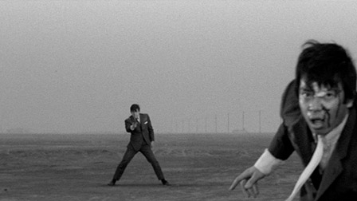
WHAT LED TO THE JAPANESE NEW WAVE
Post war –studios experiment with new genres
Toho: Monster Movies (Godzilla)
Toei: Yakuza / Gangster Movies
Daiei goes bankrupt
Nikkatsu: Ahem, I choose not to write this here because I’d like to keep my job.

Slide 15
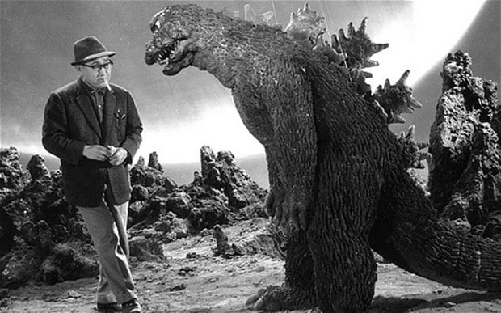
This movement of genre led to a drop in quality. Independent artists responded by offering more challenging movies.
These artists were named the Japanese New Wave to parallel the movement in France
(We’ll get to that)

Slide 16
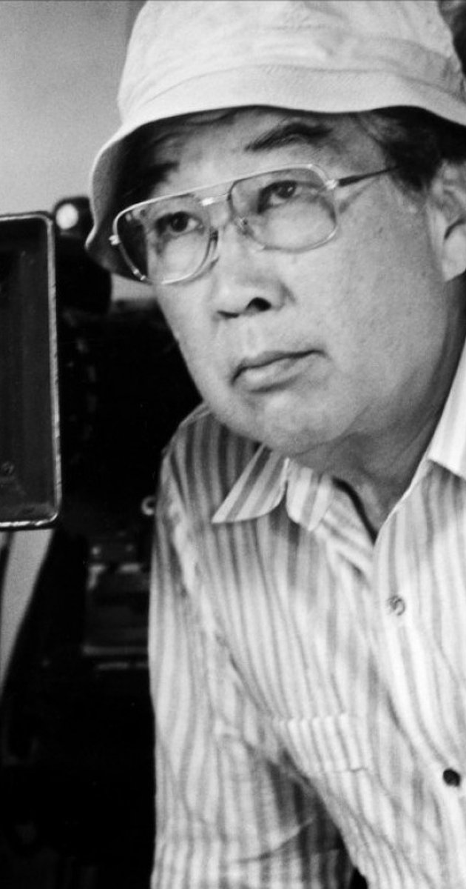
Shohei Imamura
Self described as “ethnographic” –describing groups and individuals whose habits and traditions are frequently repellent. (This term comes from his 1966 film named The Pornographers: An Introduction to Anthropology)
Meant to inspire simultaneous sympathy and repugnance
Included shots of insects or reptiles to inspire similar feelings
Black Rain (1988) –ethnographic look at Hiroshima
Nagisa Oshima
Considered the most “modern”
Similar techniques to Godard (We’ll study him soon)
Often challenged Japanese moral assumptions and institutions
“The values of the older generation are seen as neither valid nor relevant to the problems faced by youth…”
Condemned society; had unorthodox views on crime and punishment
Mixed reality and fantasy
Left film in the ‘70s to become a political commentator

Slide 17
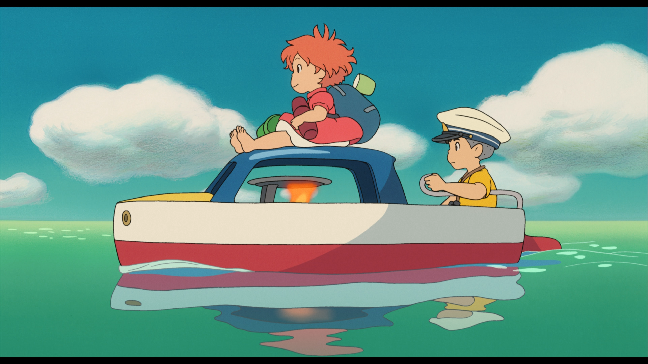
WHAT HAPPENED TO JAPANESE FILM?
Like America, TV draws attention away from cinema (mid-1970s)
Leading film export: Animation or anime (inspired by Japanese woodblock prints)
Anime: often use Western looking characters
Notable director: Hayao Miyazaki (My Neighbor Totoro, Ponyo, Princess Mononoke, Spirited Away)
Notable films: Ghost in the Shell, Akira

