Slide 1
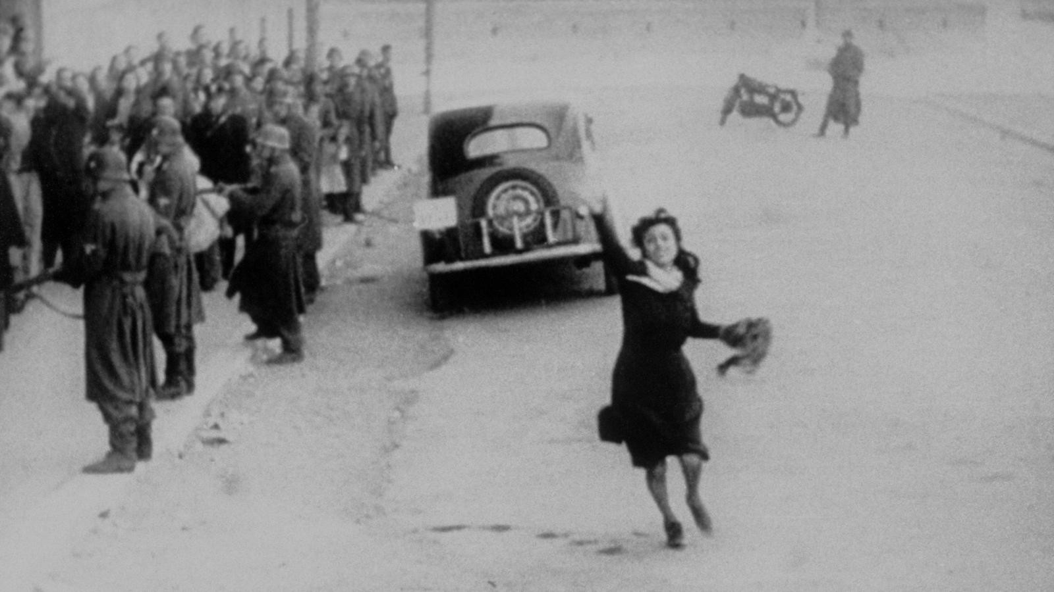
What might be unique about Italy
trying to make movies after 1945?

Slide 2
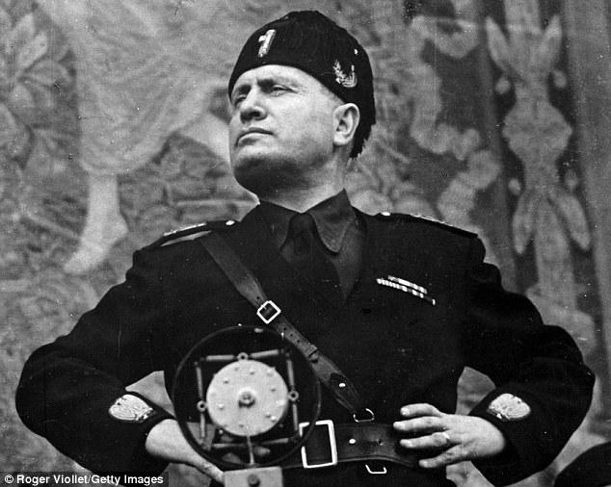
Film under Mussolini:
Heavily controlled under Fascist government
Mussolini tried giving some of his good-for-nothing relatives jobs in the film industry
Desperately tried, but failed to make effective propaganda
Settled for “as long as you weren’t thinking of the government, you’re okay”
Operas
Costumed melodramas
Romance

Slide 3
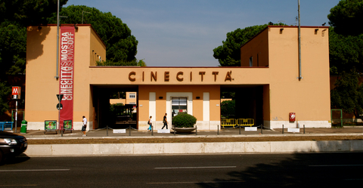
1935 –National Film School opens (Roberto Rossellini, Pietro Germi, Michelangelo Antonioni)
1937 –Cinecetta / Cinecitta Studios opens (Luchino Visconti, Federico Fellini) –Hollywood on the Tiber

Slide 4
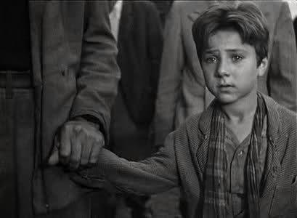
ITALIAN NEOREALISM
First seen in Roberto Rossellini’s Open City (Sometimes named Rome, Open City. As a favor to yourself, watch this movie. It may not destroy you, but you are a better person for doing so.)
Casare Zavattini defined Neorealism
The necessity of a story is an unconscious way of disguising human defeat
The director’s role is not to move an audience, but make them reflect on what they and others are doing.
If you are moved, this is secondary.
Other film philosophies encourage pushing one scene to the next. Neorealism encourages you to stay in the scene and deal with the ramifications of what has just happened.

Slide 5
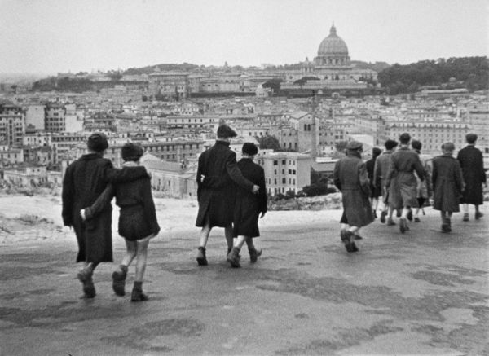
ITALIAN NEOREALISM CONT’D
Based on fact more often than fiction
Semi-documentary format (actors took primary roles; real people filled in secondary parts)
Addressed sociological and psychological issues rather than entertainment
Loose plot

Slide 6
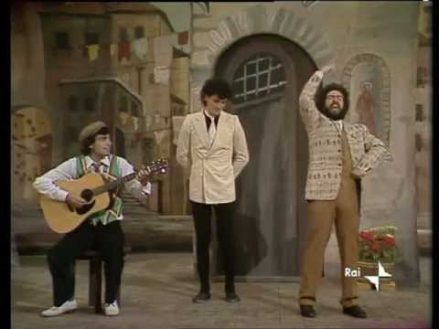
Sceneggiata –a type of stage performance involving nonprofessionals doing melodrama with song
Inspired Elvira Notari in the 1920s and 1930s
Because of economic downturn post-war, this made the most amount of sense

Slide 7
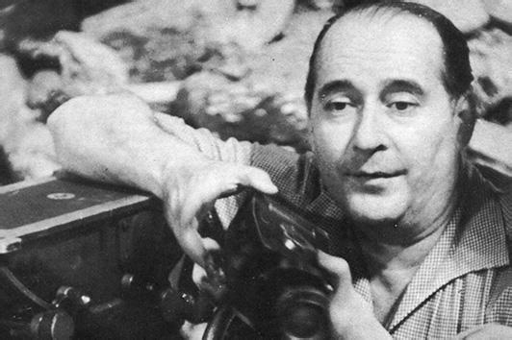
Roberto Rossellini
Directed Open City (1945) and Paisan (1946)
Dealt with the theme of the conquered (Italy) dealing with the conqueror (America)
Themes complex: starts with a distrust and builds into a closeness
Figured things out as he went along
Camera and editing very sparse

Slide 8
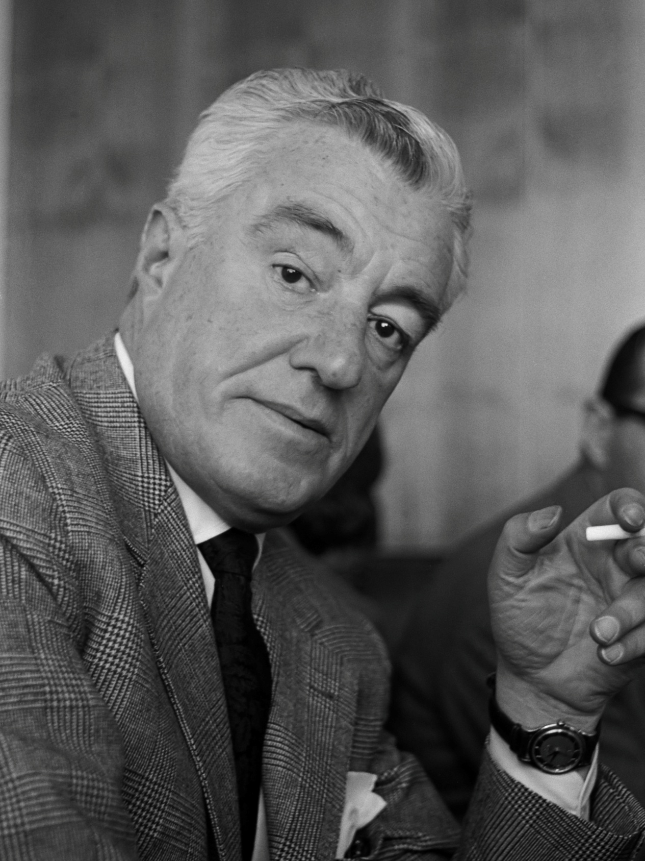
VITTORIO DE SICA
Directed The Children are Watching Us (1943) and The Bicycle Thief (1948) –sometimes named The Bicycle Theives
Worked with Casare Zavattini (screenwriter mentioned earlier)
Like with most neorealists, de Sica comments on the social concerns of Italy, but never really addresses the causes or solutions of those problems
The lead actors in The Bicycle Thief are both nonprofessionals. The father was a machinist and the boy was a newsboy.

Slide 9
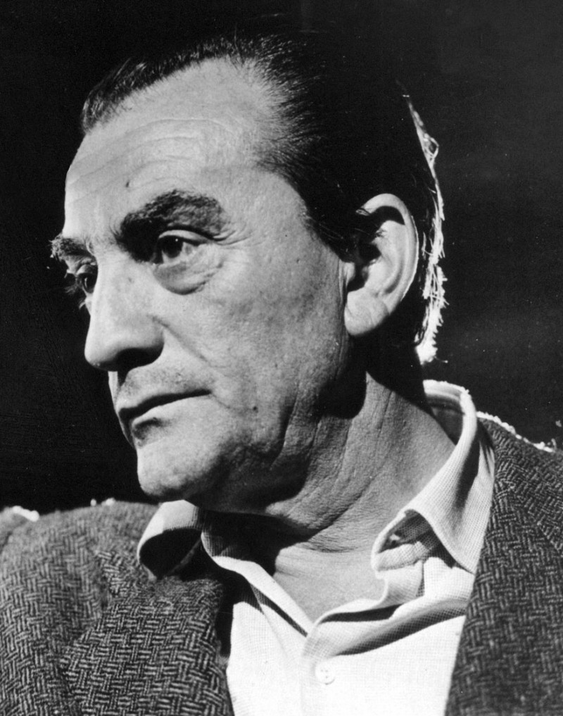
LUCHINO VISCONTI
Accidental originator of much of neorealism
Made antifascist and critical films during Mussolini’s reign
Directed Ossessione (1942) and La Terra Trema (1948)
His movies were bleak when the mandate from the government was to make happy and encouraging films
Almost more similar to Sergei Eisenstein in terms of tone.

Slide 10
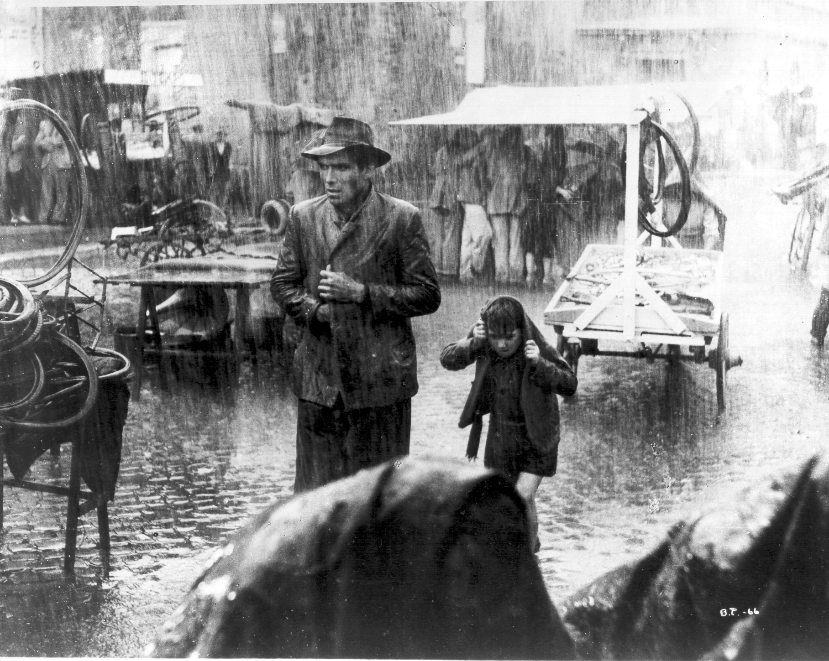
Look at your definition of Italian Neorealism according to Zavattini. What problems might the movement run into?

Slide 11
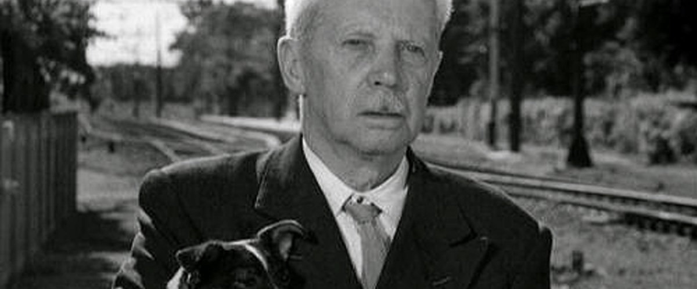
The Death of Italian Neorealism
Last TRUE Italian Neorealism film –Umberto D (de Sica)
Roman Catholic Church and Italian government condemn sending social pictures overseas
Without American money, Neorealism can’t be financed
Move from focus on the struggles of the poor to the corruption and decay of upper class
Fellini makes La Strada, focusing on inadequacies of human relationships; seen as a betrayal of Neorealism
Fellini’s response: “Reality needs poetry.”

