Slide 1
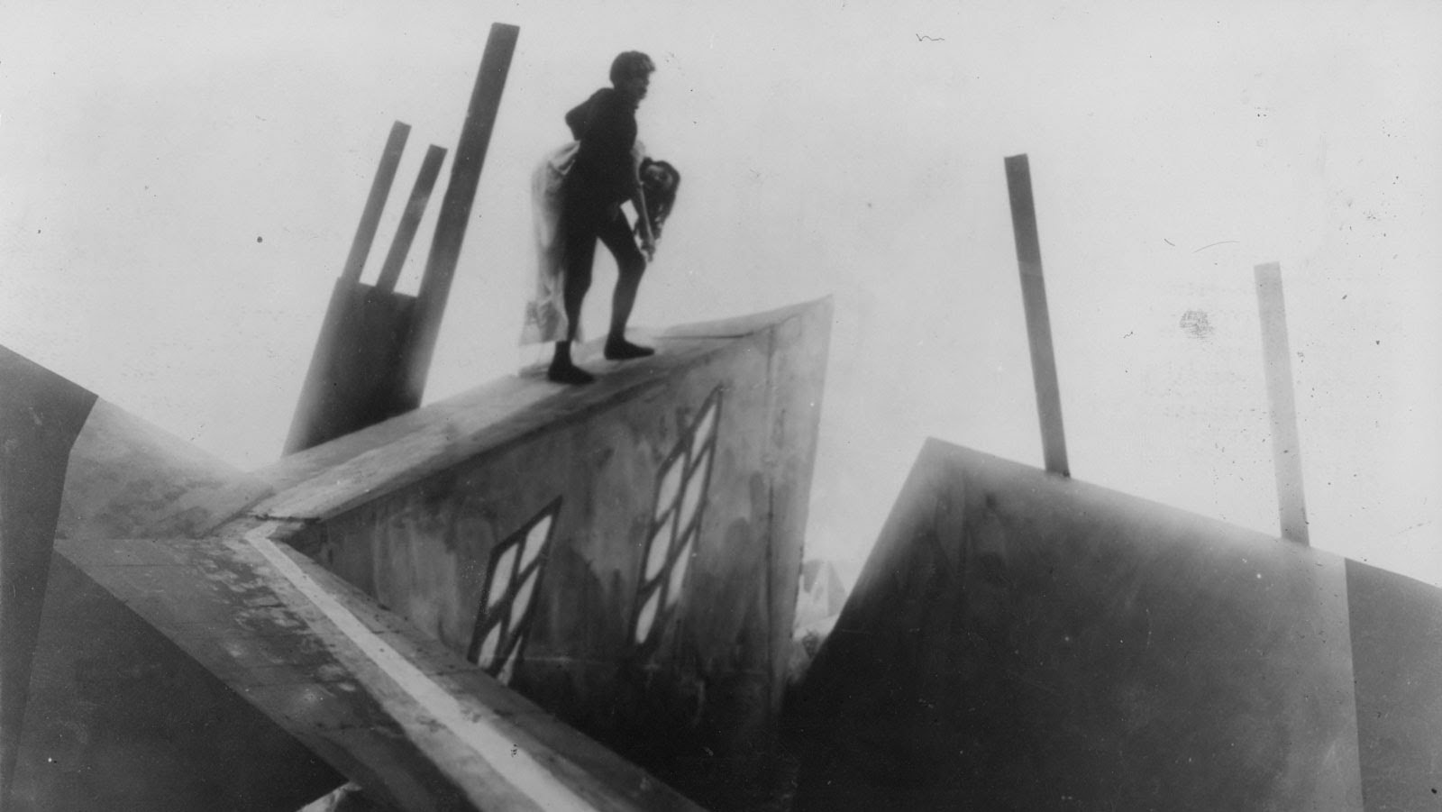
How has German Expressionism influenced modern film?

Slide 2
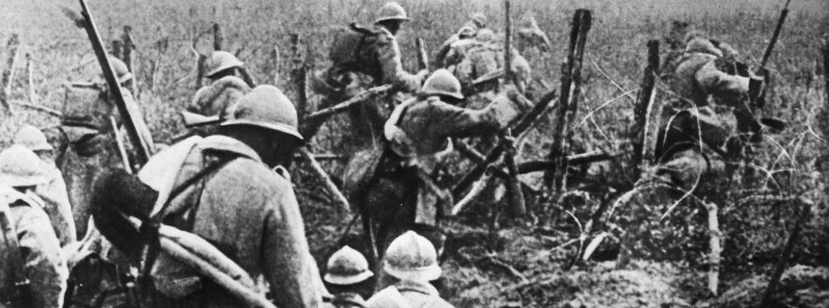
Weird paradox:
Post World War I, Germany is at an all time low. Inflation, unemployment, and food shortages crippled the country.
This is the highest point for German film (1922-1924)
As a contrast to typical German philosophy, the beliefs of Germany were about amorality and decadence.

Slide 3
BERLIN
Center of art in Germany
Saw film with more potential than Americans
Germans develop more complex tones than Americans (Not necessarily good guys and bad guys, but morally / philosophically complex)

Slide 4
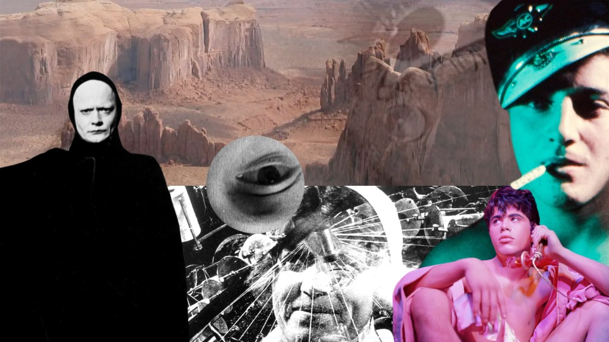
Classicist, Formalist, Realist: All film exist on a spectrum between documentary and experimental / avante garde
Realism: Leans towards documentary. Wants to show the world as it really is.
Formalism: Everything is intentionally crafted; creates a sense of a heightened cinematic world
Classicism: Right in the middle. You often forget you are watching a movie because often choices are safe to serve the story.
Classicism, Formalism, and Realism Explained: YouTube

Slide 5
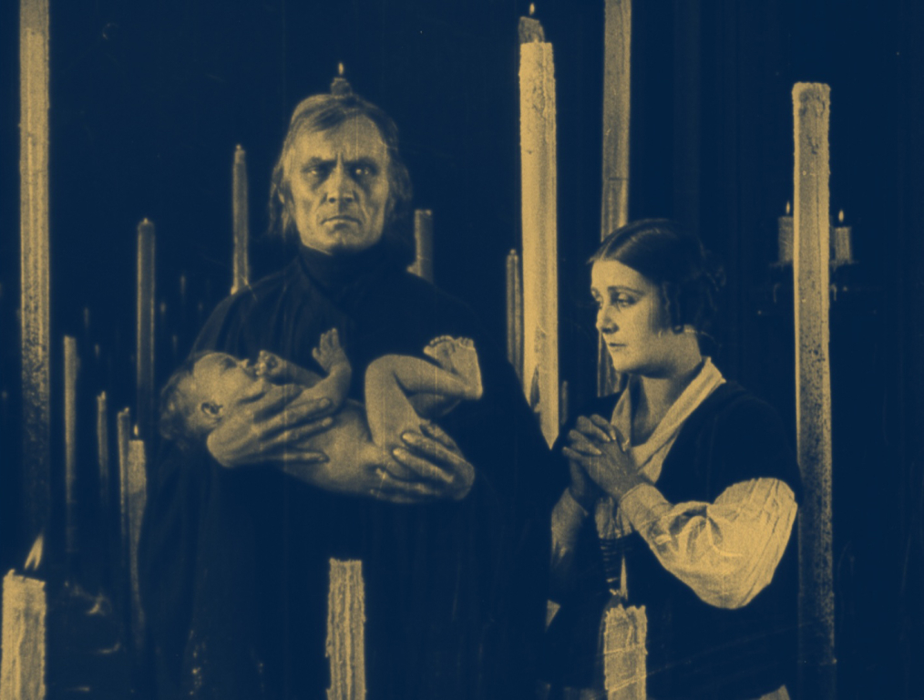
HISTORICAL / MYTHOLOGICAL FILMS or HISTORICAL FANTASIES
Architectural settings
Careful costuming
Romantic lighting
Massive crowds
Stylized
Directors and films to know:
Ernst Lubitsch –Passion (1919), Deception (1920)
Fritz Lang –Destiny (1921), Metropolis (1927)

Slide 6
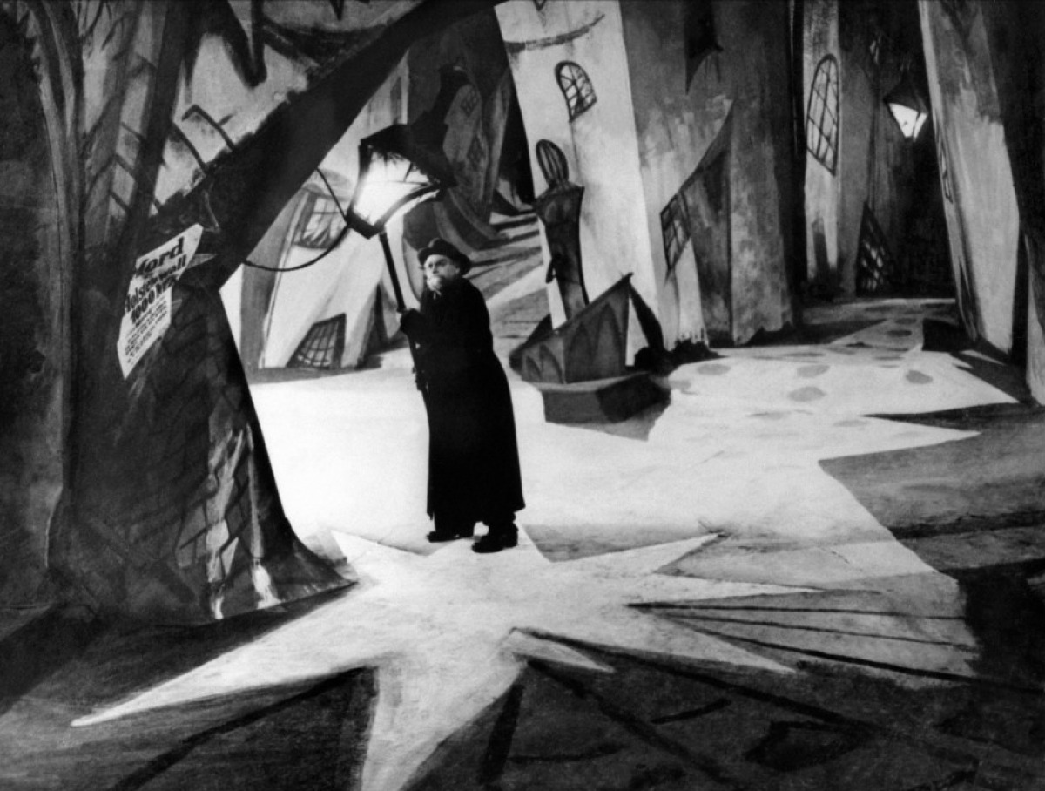
EXPRESSIONIST FILMS
Sinister and macabre
Décor is exaggerated
Fast motion
Negative images
Superimposition
Stop motion
“Films must be drawings put to life”
Most famous film in this submovement:
Robert Wiene’s The Cabinet of Dr. Caligari
Other films: Paul Wegener’s The Golem and F.W. Murnau’s Nosferatu

Slide 7
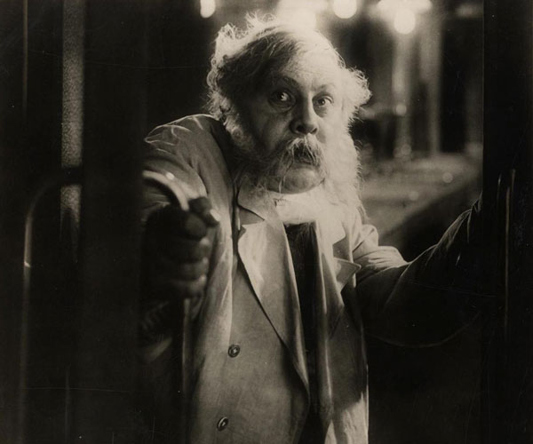
Kammerspiel film
Also known as “chamber play film”
Focuses on the lower middle class
Unity of time, place, and action
Virtually no intertitles
Few characters
Sparse décor
Objects given extraordinary importance
Intimate psychological content

Slide 8
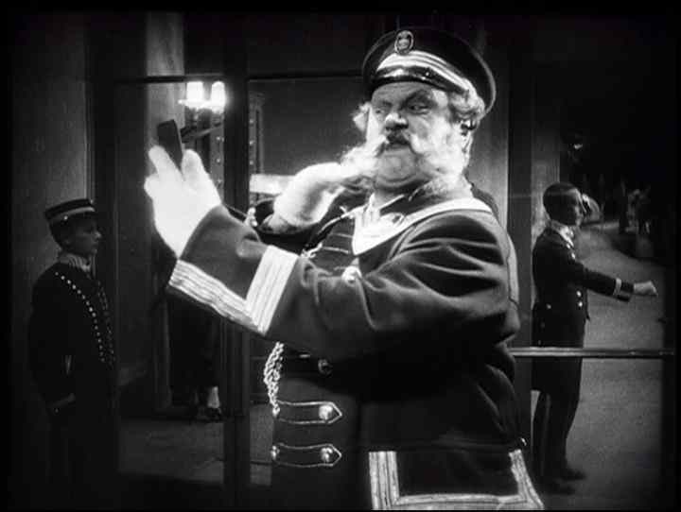
The Last Laugh (1924) –F.W. Murnau
Germans obsessed with psychology v. sociology
Championed the moving camera.
Griffith panned and tilted; Germans moved camera itself

Slide 9
German Directors to Know
F.W. Murnau
Nosferatu
The Last Laugh
Sunrise
Fritz Lang
Dr. Mabuse, the Gambler
Metropolis
M

Slide 10
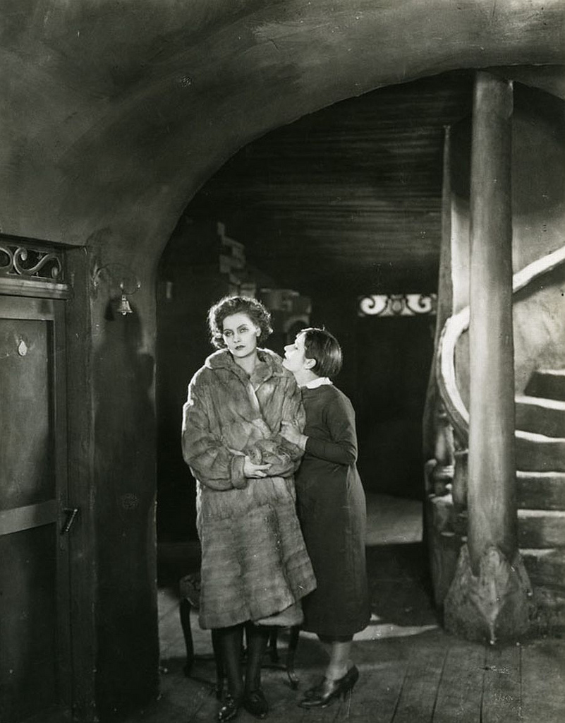
STREET FILMS
Subcategory of Kammerspiel films
“…the male protagonists are drawn away from home, family, and the bourgeois life by the lure of the city –the seductive promise of excitement and sensual pleasures” (42).
Plots are considered “morbidly sentimental”
Major Street Films
Karl Grune –The Street (1923)
G.W. Pabst –The Joyless Street (1925)
Bruno Rahn –Tragedy of a Street (1927)

Slide 11
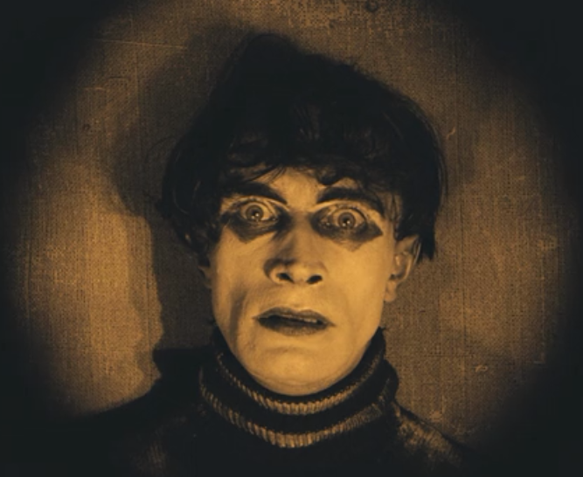
IMPORTANT CONCEPT:
German film makers were preoccupied with the psychological rather than the social

Slide 12
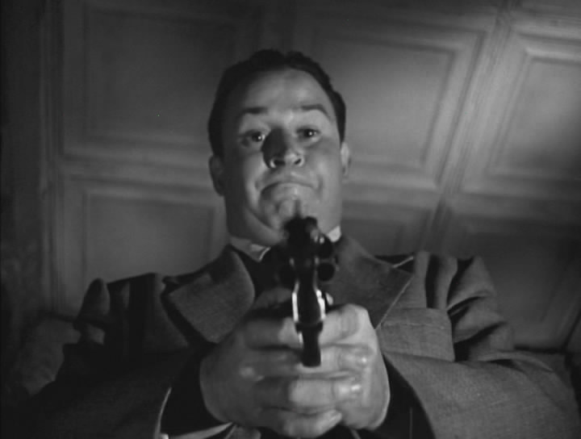
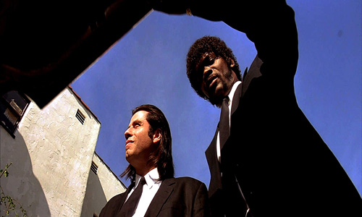
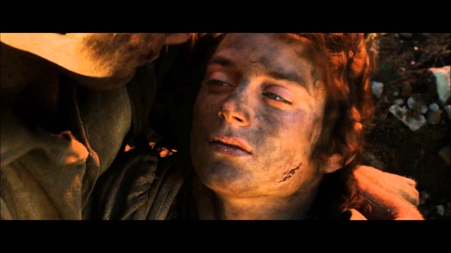
Points of View + Effects
Subjective Camera gives insight into character’s state of mind
Low Camera Angle -exaggerates size and importance.
High Camera Angle -emphasizes vulnerability

Slide 13
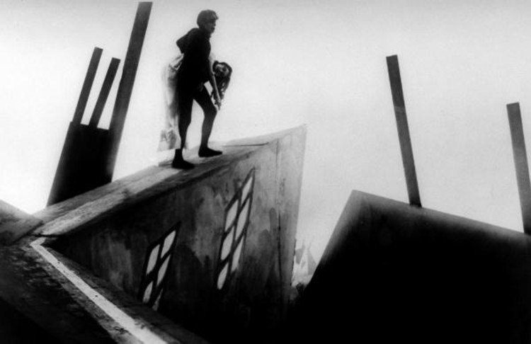
OTHER MAJOR ADVANCEMENTS
Set design –exaggerated and huge; spectacle was very important
Scripts
Americans were very improvisational; Germans had very detailed scripts and plans
Performance styles –move away from theatrical
Attempt to capture psychological states; simplified performances
Lighting –played with light and shadow
Low-key light: very low light; screen goes dark; many scenes set at night or by candlelight
Key light: A powerful light on screen, like a window beaming in a stream of light

Slide 14
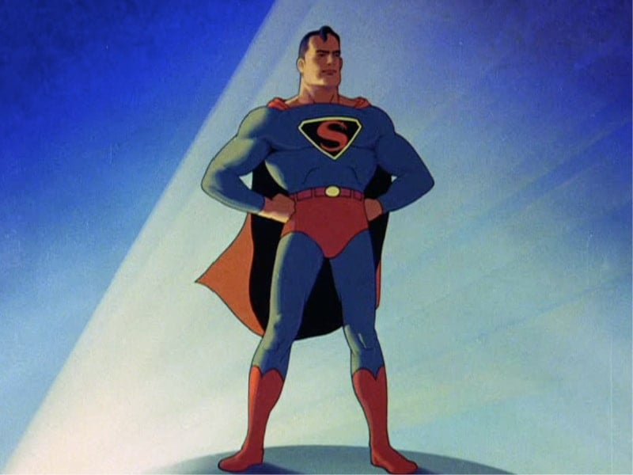
Animation Terms:
Key framing: Animators choose starting point and ending point for character and fill in every frame between to create movement
Cel animation: Animator only has to make changes to element that moves
Rotoscoping: Animating over existing live action
Multiplane Camera: Took different layers of animation that moved to the camera, allowing objects to maintain distance
The Early Days of Animation on YouTube

Slide 15
Mise en scene –Anything that appears before the camera and its arrangement
Composition
Actors
Lighting
Props
Costumes
Sets

Slide 16
Lighting and Sets
American Method:
Take out roof for interior lighting
Film on location whenever possible
German Method:
Light multiple areas to establish mood and draw attention
Build massive sets for both indoor and outdoor scenes.

Slide 17
Acting is based on camera (nuanced)
Script very detailed with drawings and specific lines
Acting is based on stage acting (exaggerated)
A lot of improvisation on script

Slide 18
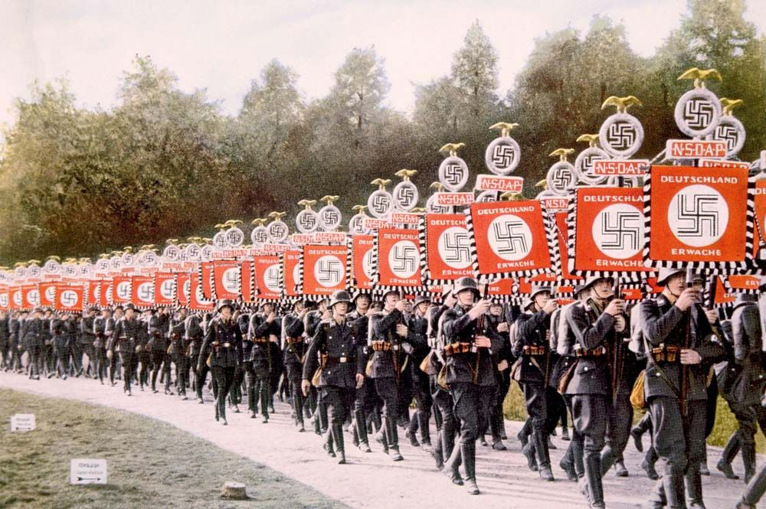
Rise of the Third Reich leads German directors and actors to flee. A lot of these artists, including Peter Lorre, Ernst Lubitsch, and Fritz Lang would be scooped up by Hollywood studios. (We’ll catch up with them in future units.)

