Slide 1
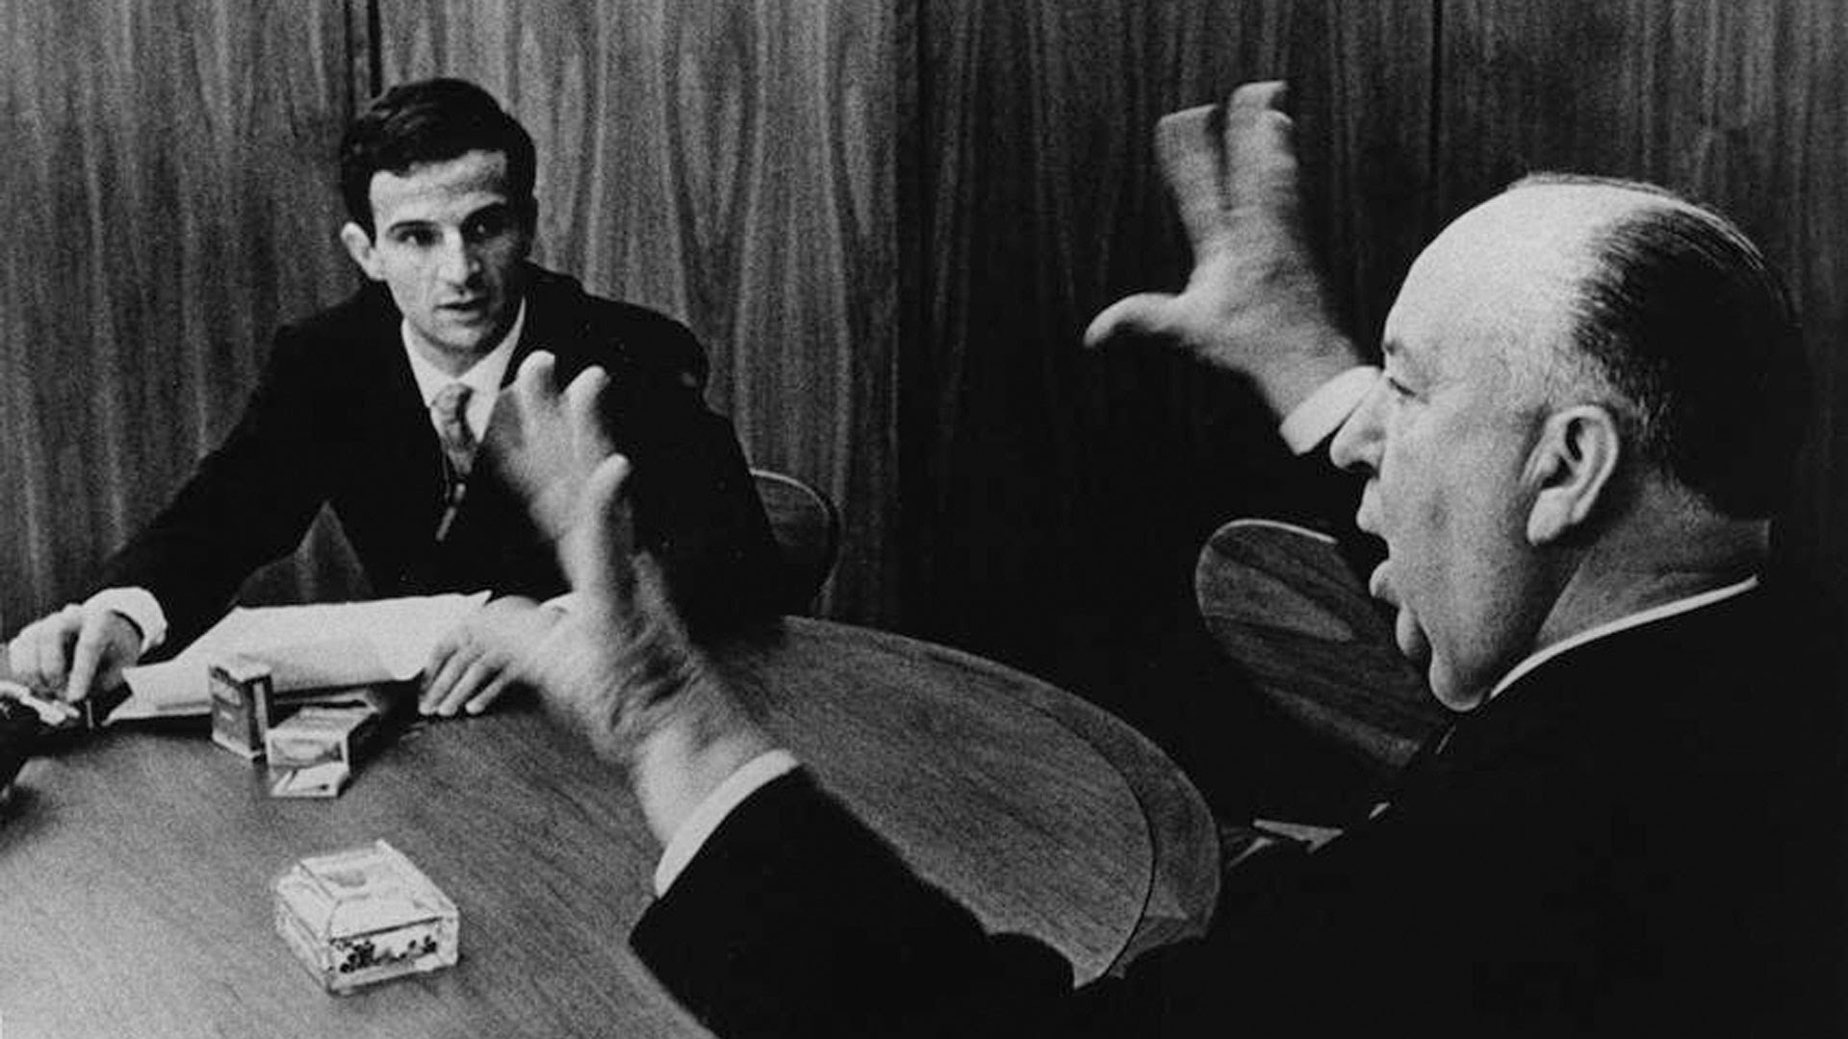
Define auteur.

Slide 2
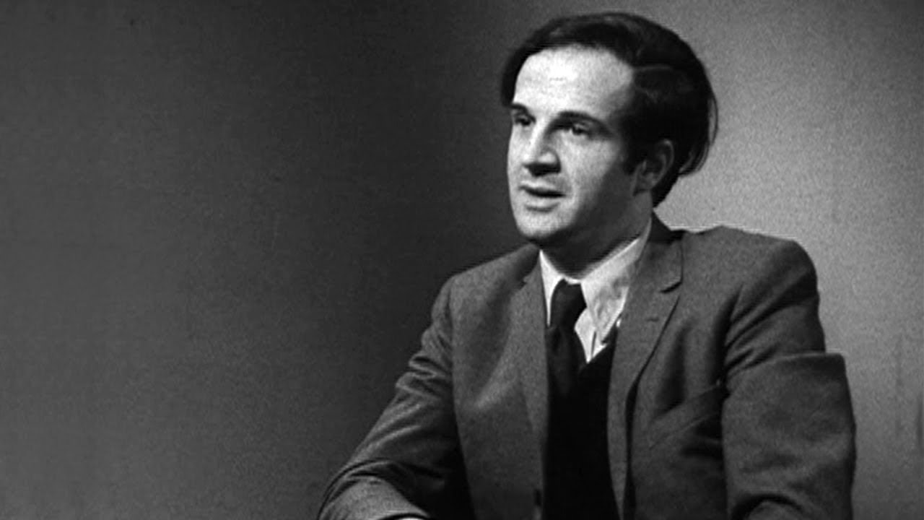
Francois Truffaut
Wrote an article against France’s literary tradition
Films were too much about the screenplays and the screenwriters
Directors should be the primary influence over their films tonally
They should be involved in every aspect of the production from conception to execution
Could not believe in the coexistence of “the tradition of quality” and “a cinema of auteurs”

Slide 3
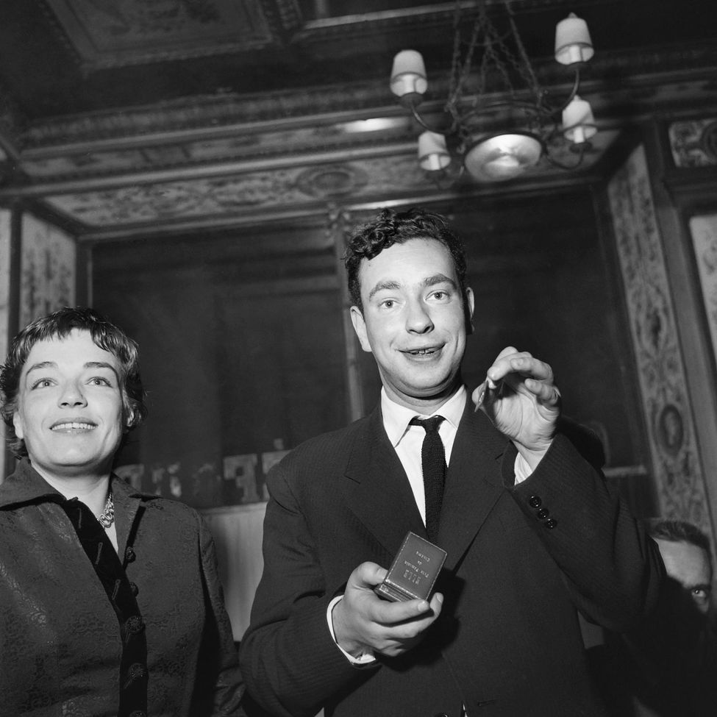
Ideas That Led to Truffaut's Comments
1948: Alexandre Astruc calls film “la camera-stylo” (“the camera as pen”). Film is more than images and sound. It is in its making.
France releases National Film Archives, inspiring new directors.
Post war: glut of films from America banned by German occupation (seeing how film progresses in one sitting)

Slide 4
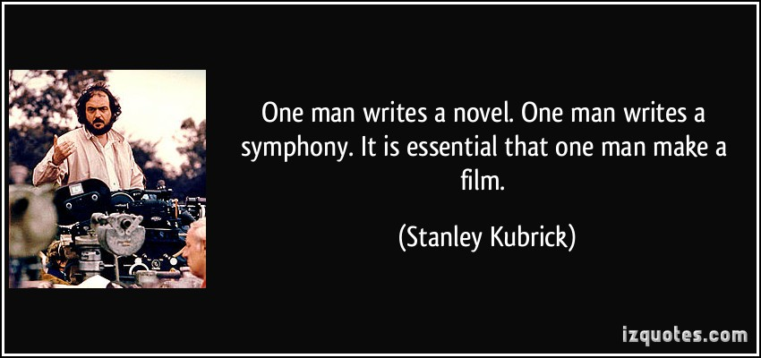
Autuer theory –some directors are the sole creators of their works
Mistranslated from “la politique des auteurs” –meaning “the policy of the auteur”
Some directors were respected by the French (Otto Preminger, Nicholas Ray, Douglas Sirk)
Some directors were merely adapters of others’ works (William Wellman, William Wyler, Robert Wise)
Auteur theory eventually moves west to U.S. and Great Britain

Slide 5
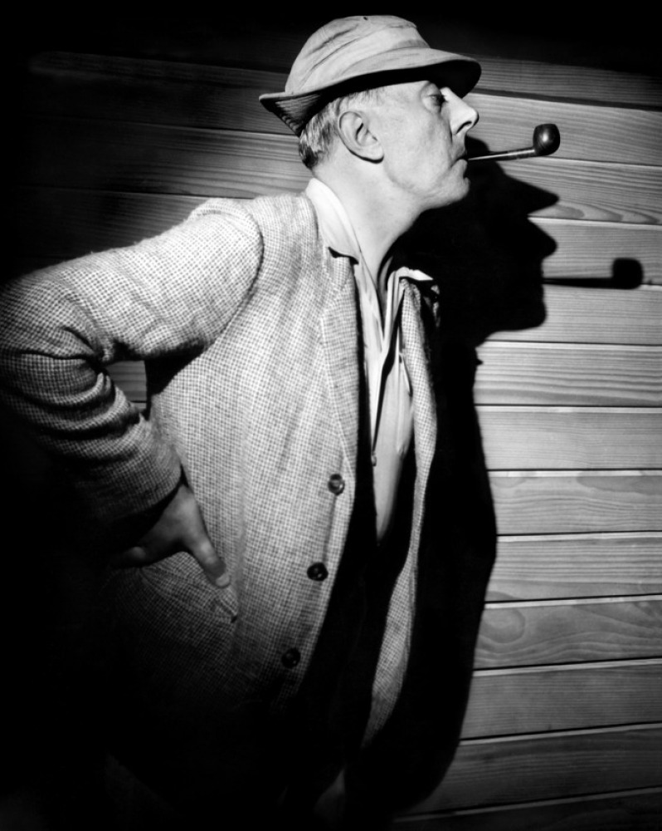
Jacques Tati
Precursor to New Wave
Often did bizarre comedies starring a silent protagonist
Inspired New Wave with Jour de Fete (1949), Mr. Hulot’s Holiday (1953), and Mon Oncle (1958)
During the actual height of his popularity, did absolutely nothing.
Became critical of society with his last two films, Playtime (1968) and Traffic (1971). Became basis for postmodernist theorists
Films largely abstract
He played his own protagonist, Monsieur Hulot

Slide 6
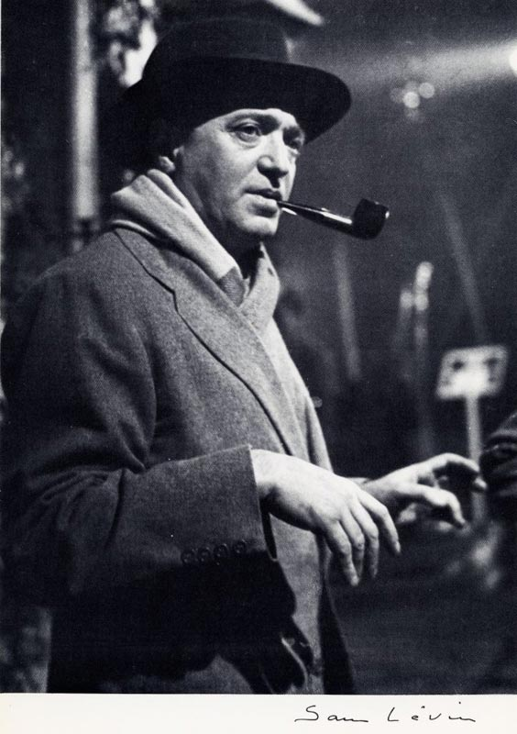
Max Ophuls
Actually German, but did a lot of his work in France
Famous films: La Signora di Tutti (Italy 1934), Letters from an Unknown Woman (USA 1948), The Earrings of Madame de…(France / Italy, 1953), La Ronde (1950), Lola Montez (France / Germany)
Liked period pieces because it allowed him to be opulent
Loved crane and dolly shots
Considered a self-reflexive romantic
Themed around passionate commitments and the sensitivity of women
P.S. Not everyone in France smokes pipes. The others smoke cigarettes.

Slide 7
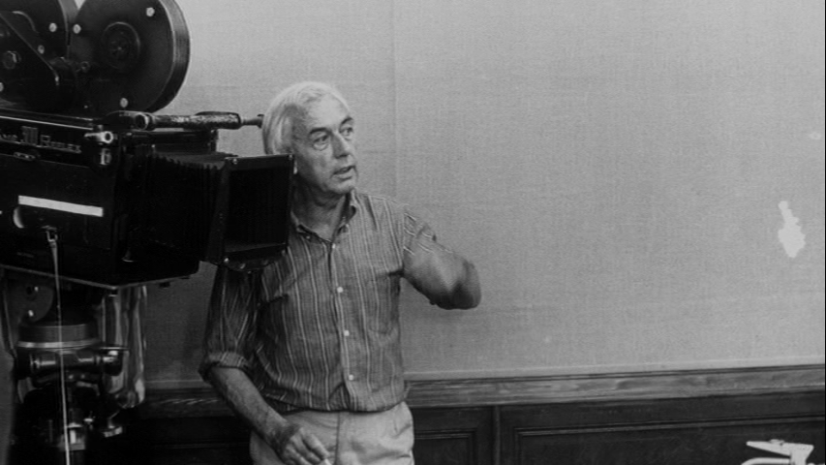
Robert Bresson
Restrained, straightforward style (Opposite from Ophuls)
Career from 1930s to 1990s, but only 13 films
Themed around moral and theological questions rather than psychological
Insistence on rigorous control over every aspect of production
Actually Catholic humanist, he is accused of being the “Jansenist of French cinema”
Famous film: Diary of a Country Priest (1950)

Slide 8
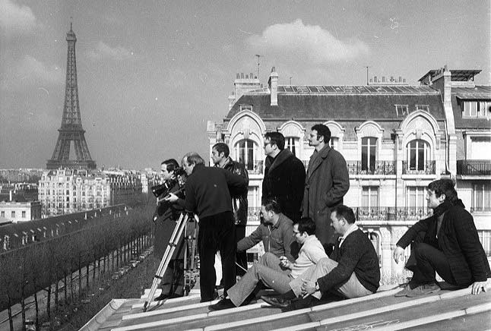
Take a guess. Where do you think the New Wave directors came from? (Note: This is practically unique in film history.)

Slide 9
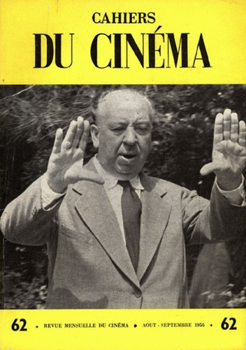
THE EMERGENCE OF THE NEW WAVE DIRECTORS:
Francois Truffaut, Jean-Luc Godard, Claude Chabrol, Jacques Rivette, and Eric Rohmer
Post 1946 –Government puts restrictions on film (French films must be shown for 16 weeks of the year)
No new films being made
1948 –Government finances producers of films to encourage French film
Producers got rich; no one else did; movies were super safe
1953 –avance sur recettes, government financed promising movies before completed (kind of like Kickstarter)
Primes de qualite –shorts given more money based on artistic merit

Slide 10
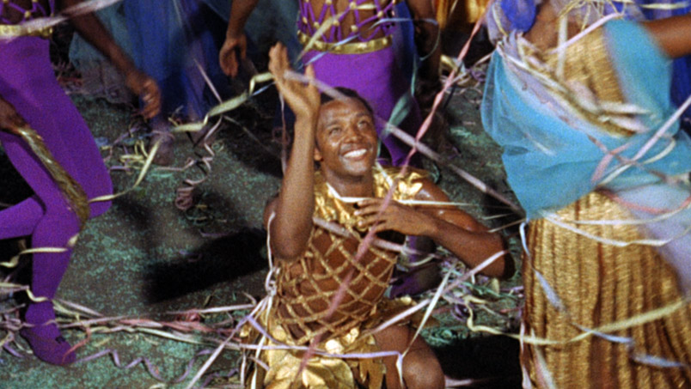
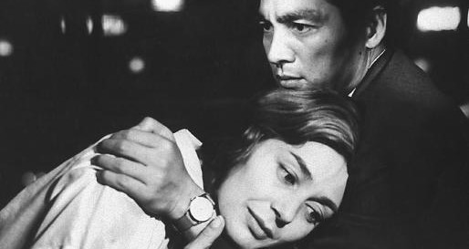
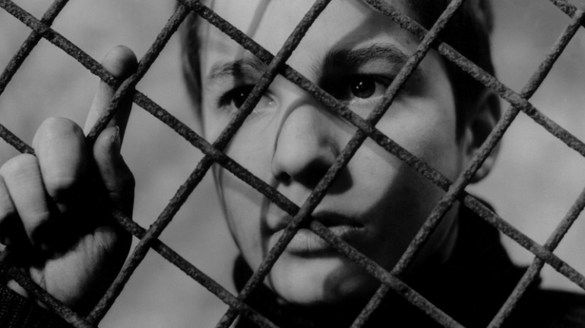
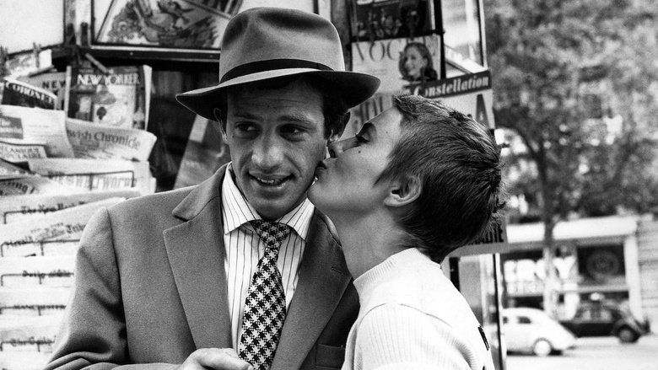
Black Orpheus (Marcel Camus -1959)
Hiroshima, Mon Amour (Alain Resnais -1959)
The 400 Blows (Francois Truffaut -1959)
Breathless (Jean-Luc Godard -1960)

Slide 11
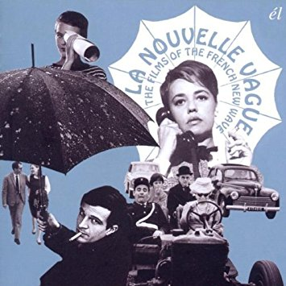
Traits of the French New Wave
Nouvelle vague –filmmakers had little in common with one another
Between 1959 and 1962, about 100 new directors started working
Existentialist philosophy –Jean Paul Sartre and Albert Camus
Distanced and antisentimental
Events rarely foreshadowed or explained
Arbitrary choices
Loose and open construction
While having a narrative, rules were more like guidelines
Playful; encouraged improv
Not confined by studios
Allusions to other films and filmmakers

Slide 12
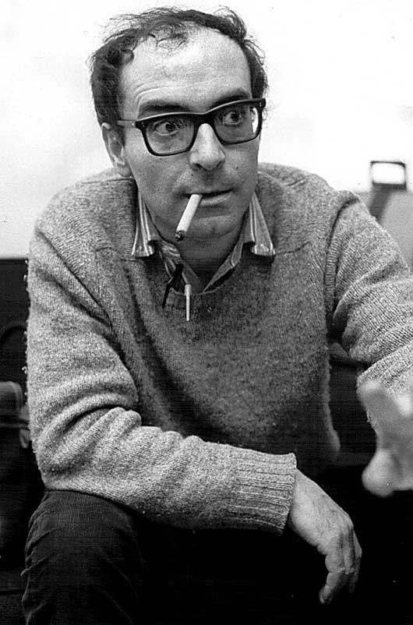
Jean-Luc Godard
Most experimental director of the New Wave
Added most to “the language of film” since Griffith or Eisenstein
Early work –variations on American melodrama
Inspired by Brecht to distance the audience
Disrupted flow addressing audience (wanted to break the suspension of disbelief)
Ironically, used cinema verite for some films, creating a new definition of realism
Famous films
Tout va Bien
Breathless
A Woman is a Woman
Band of Outsiders
Pierrot le Fou
Alphaville
Contempt

Slide 13
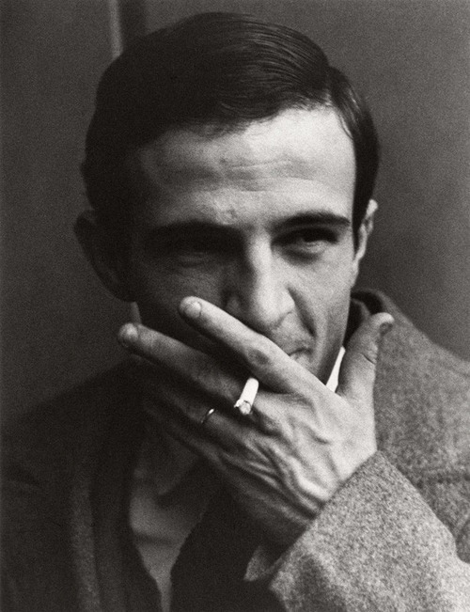
Francois Truffaut
Wrote or co-wrote all of his own films
Romantic realist
Loved to homage to other films and filmmakers (particularly Hitchcock)
Made the Antoine Doinel series, a series of films that take place over the course of one character’s life from childhood to middle age (same actor)
Films, as a whole, are semiautobiographical (his whole work, similar to Fellini)
Brought his own experiences to the screen
Famous films:
The 400 Blows
Shoot the Piano Player
The Bride Wore Black
Jules and Jim
The Last Metro
Day for Night

Slide 14
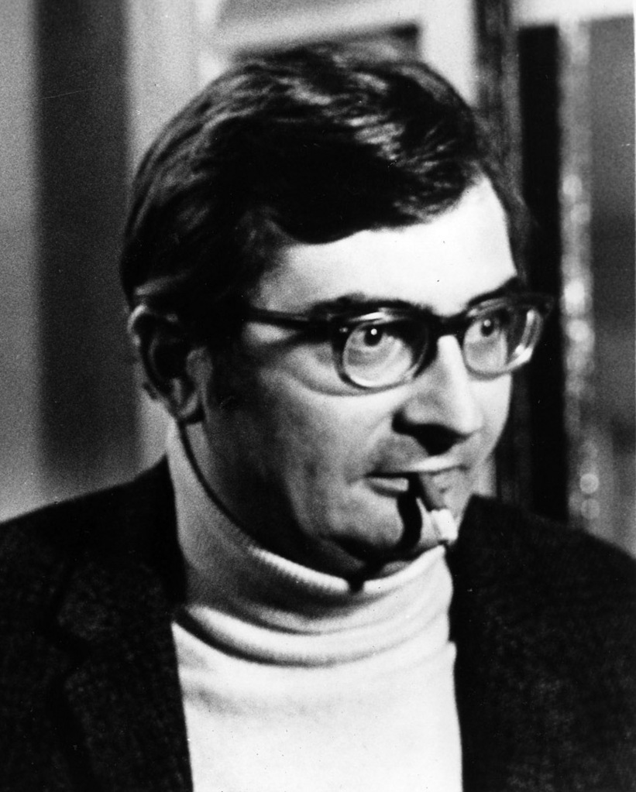
Claude Chabrol
Most films deal with ill-fated love triangle leading to death
Commented on upper class morality, or lack thereof
Would metaphorically show people stabbing each other in the backs by literally stabbing a roast
“closed films” –create a carefully controlled environment while keeping the messiness of the real world out of it.
Mimicked and respected Hitchcock and Lang
Most conventional of the New Wave directors
Famous films:
Les Biches
La Femme Infidele
Le Boucher
Just Before Nightfall

Slide 15
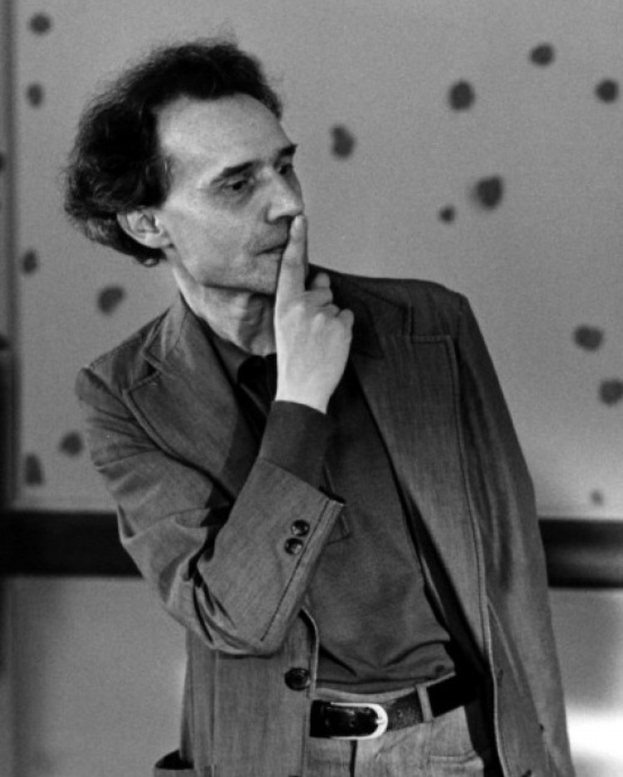
Jacques Rivette
Only made three movies during the ’60s: Paris Nous Appartient (1961), La Religieuse (1965), and L’Amour Fou (1968)
Made a 12 hr, 40 min film that was never released named Out One
It was recut and released as Out One: Spectre (1974)
Most eccentric and obscure of New Wave directors
He said that his films were “about theatre, about truth and lies”

Slide 16
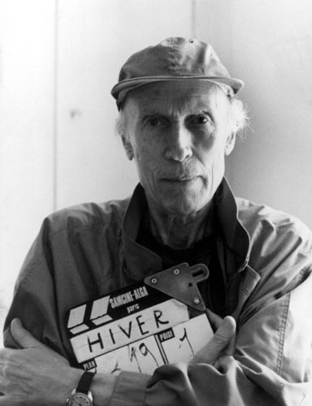
Eric Rohmer
More of a traditional French director
Rohmer was an author before becoming a director, so his films feel more “literary”
Wrote his “Six Moral Tales” as stories before he decided to film them
Characters talk a lot (probably because they were written on the page that way)
Rohmer thinks that his films deal “less with what people do than what is going on in their minds while they are doing it.”
Made movies through 2007
Truffault’s favorite modern director: “The one I like best is Eric Rohmer, but of course he is of my generation”

Slide 17
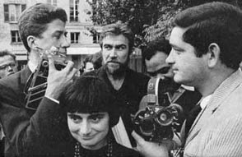
Left Bank Directors: Were not part of the Cahiers du Cinema group. Their politics were a little more left-wing and they had experience through documentary filmmaking. Their focus was on artistic experimentation.

Slide 18
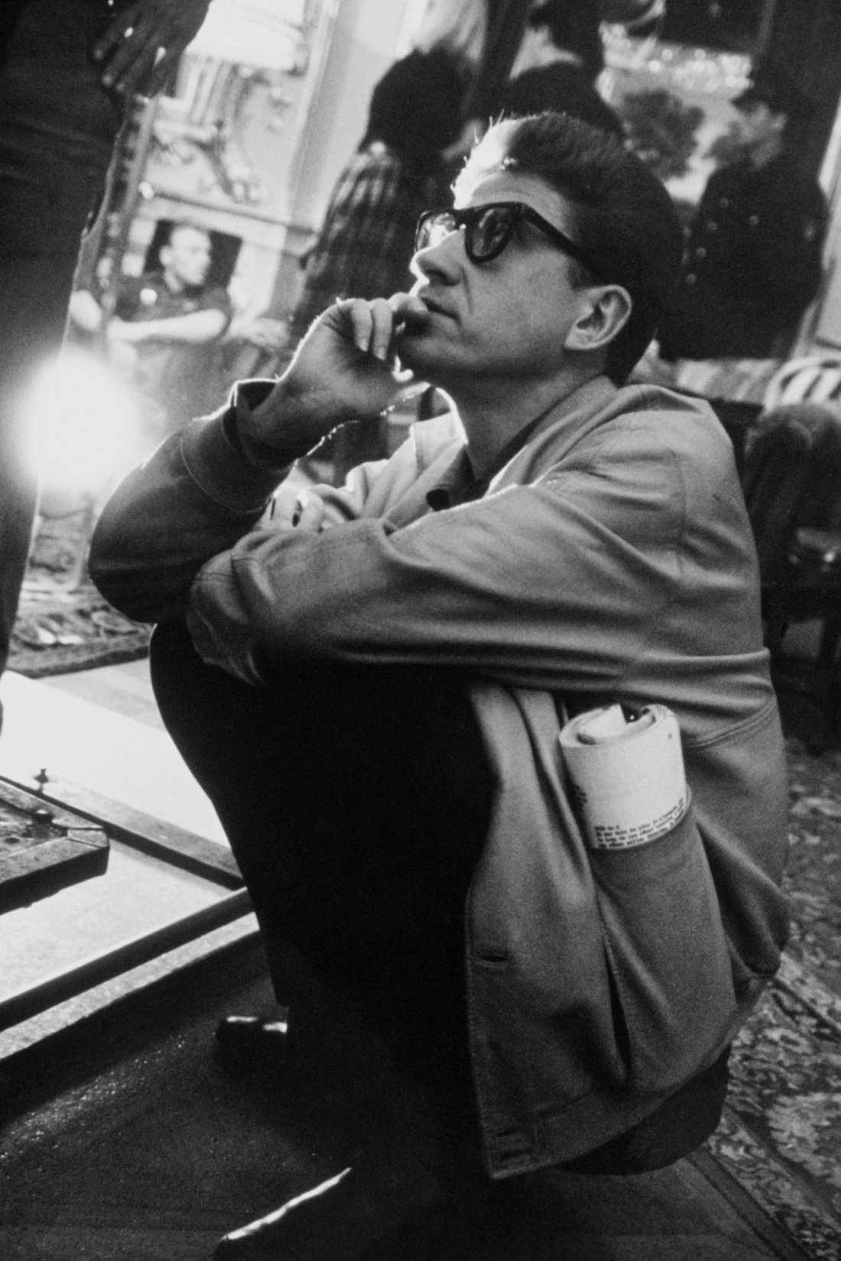
Alain Resnais
Known for technical and formal elegance
Focuses more on older characters as opposed to New Wave youth
Major theme: The past influences everything we do or experience in the present
Collaborated with screenwriters
Had no problem adapting literary work
Regardless of who wrote the script, he still have a very clear and cohesive voice
Famous films:
Hiroshima, mon Amour
Last Year at Marienbad
La Guerre est finie
Night and Fog (Documentary short)

Slide 19
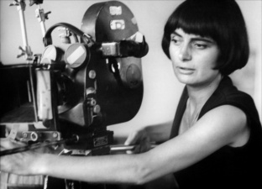
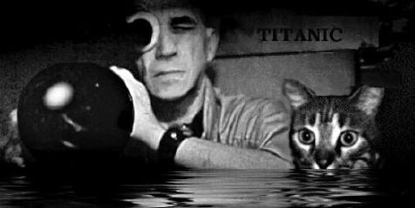
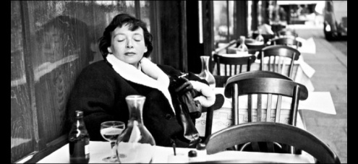
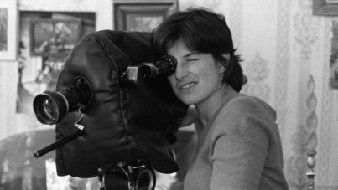
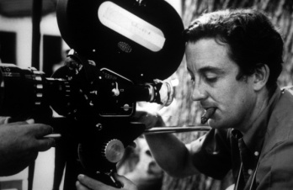
Agnes Varda
Cleo from 5 to 7
Vagabonde
Chris Marker
La Jetee
Sans Soliel
Marguerite Duras –Novelist
Collaborated on Hiroshima, mon Amour
India Song
Chantal Ackerman
Jeanne Dielman, 23 Quai de Commerce, 1080 Bruxelles
This film is straight up four hours of avant-garde filmmaking
Louis Malle
Au Revoir, les Enfants
Phantom India

